Slide 1
Tapping into water

Slide 2
We will learn about…
Why do we need water
Where our water comes from
The natural water cycle
The urban water cycle
Notes:
GIS system

Slide 3
Why do we need water?

Slide 4
wannonwater.com.au
Notes:
https://youtu.be/s0bS-SBAgJI

Slide 5
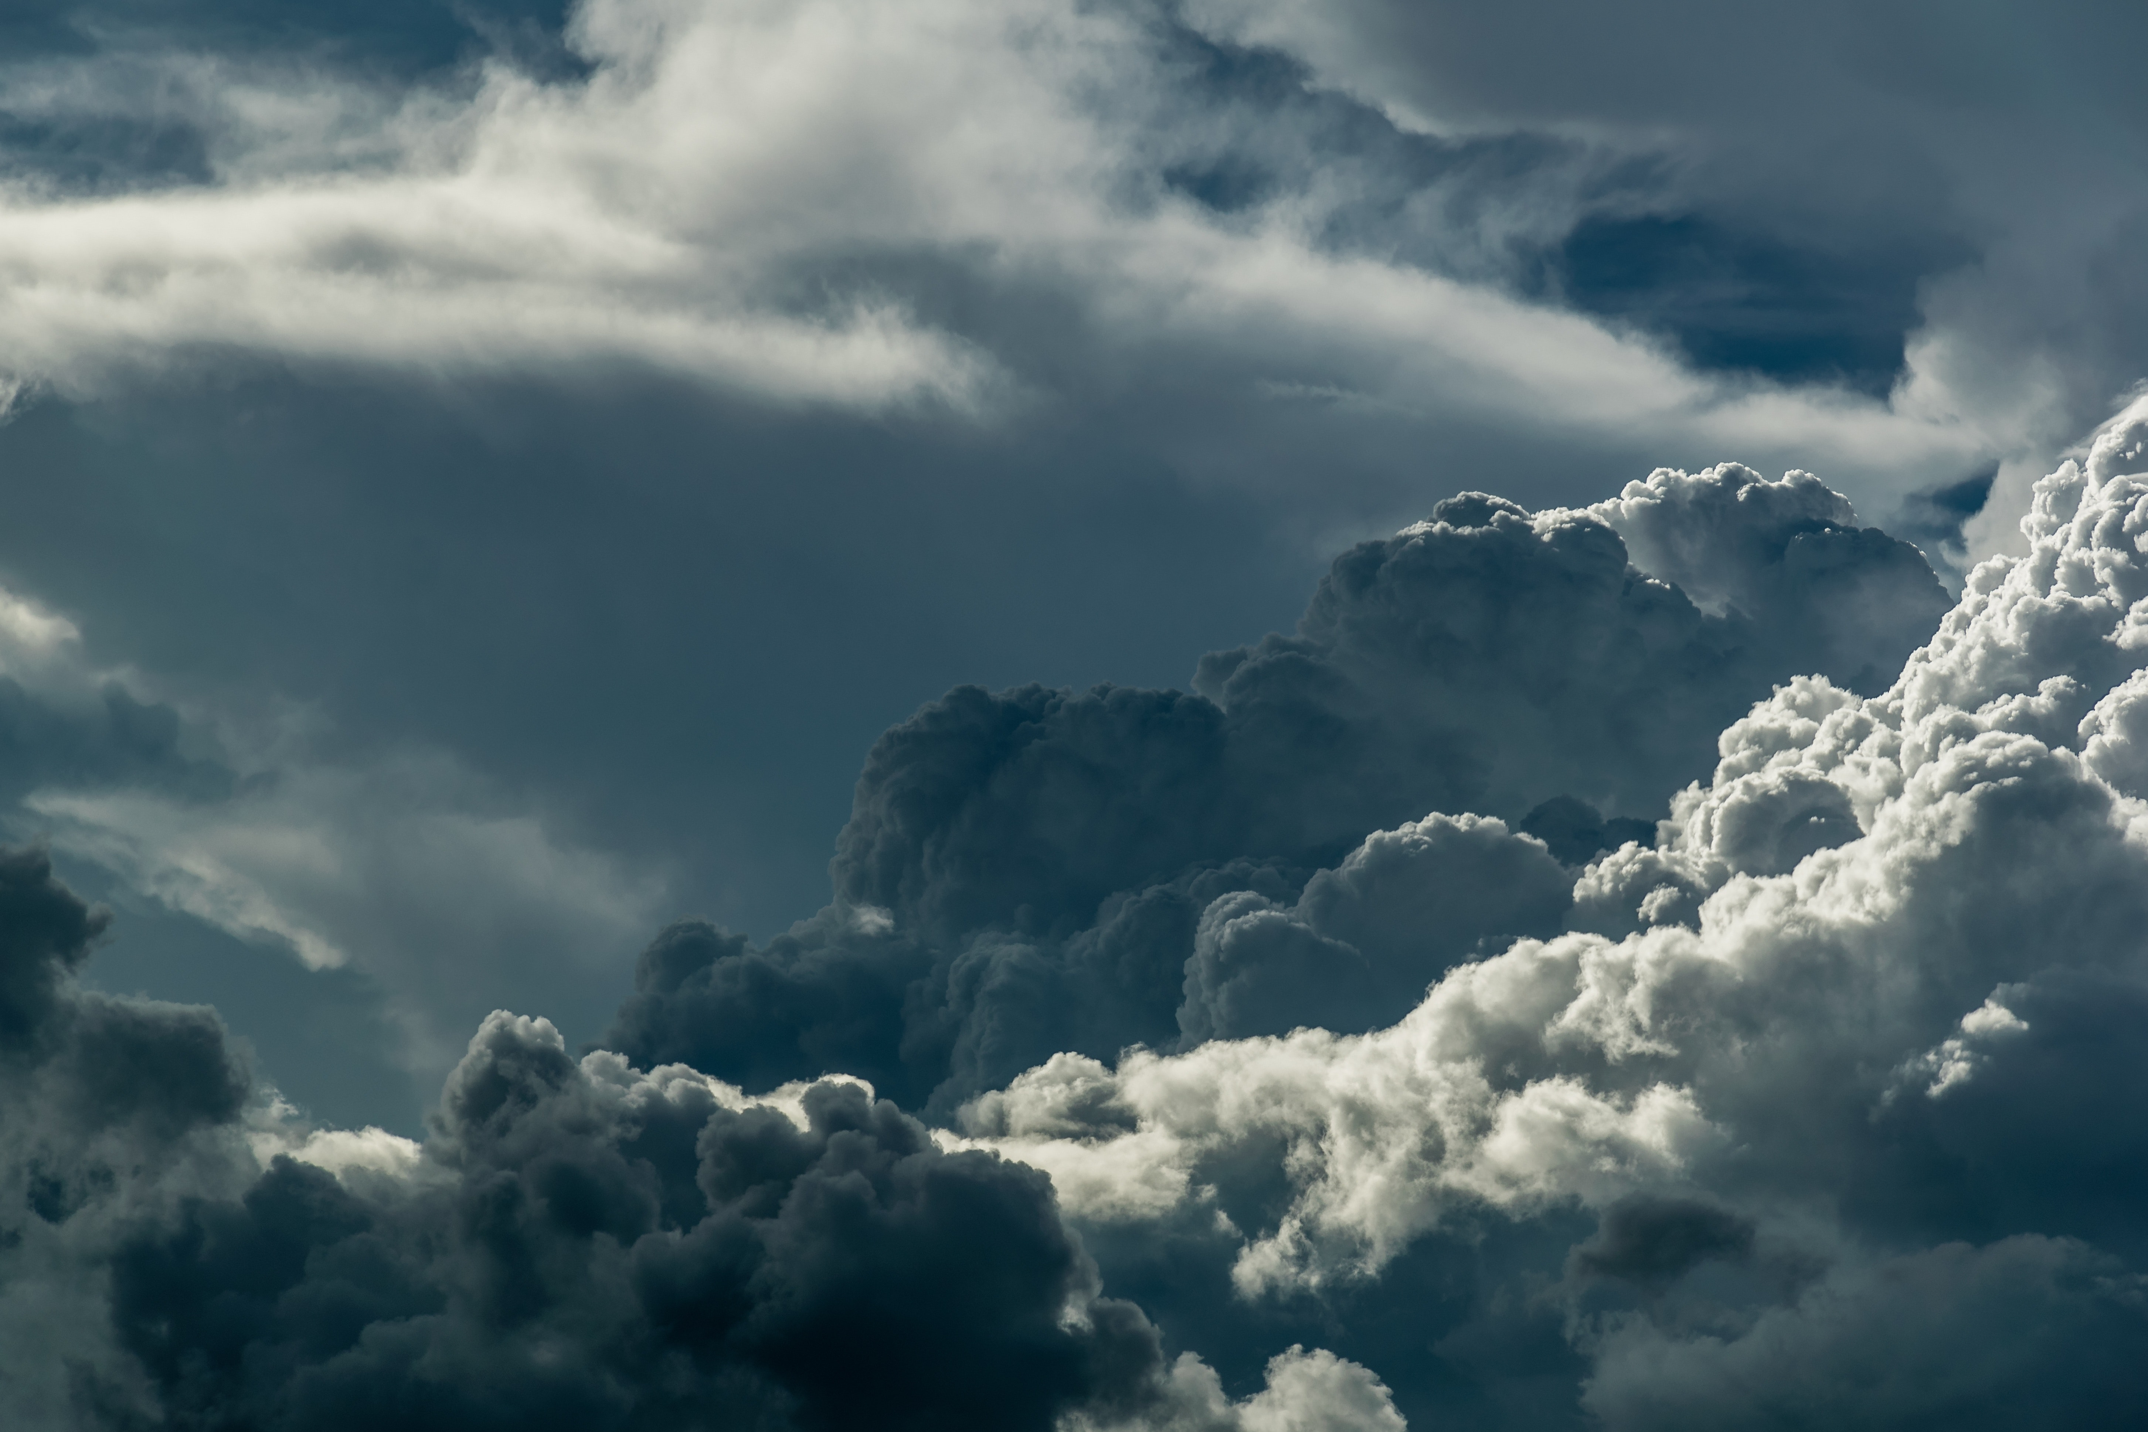
Where can we find water?
Water sources
Where can we find water?
Turn & talk activity

Slide 6
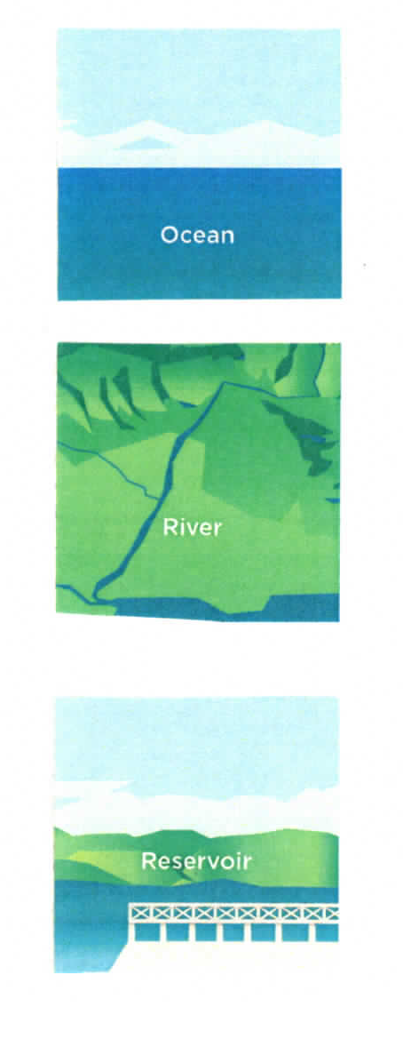
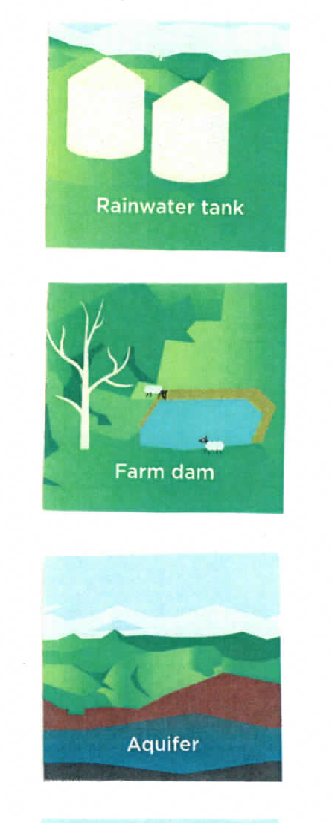
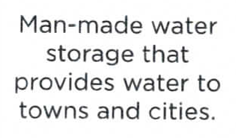
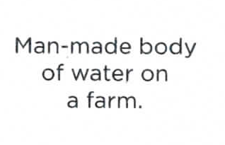
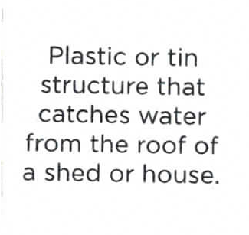
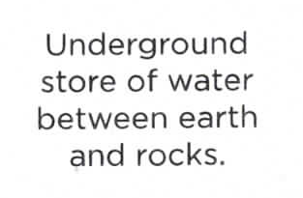
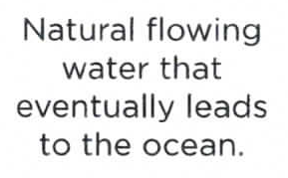
Water sources
A
B
1
2
C
D
3
4
5
E
F
6

Slide 7
Water sources match ups

Slide 8
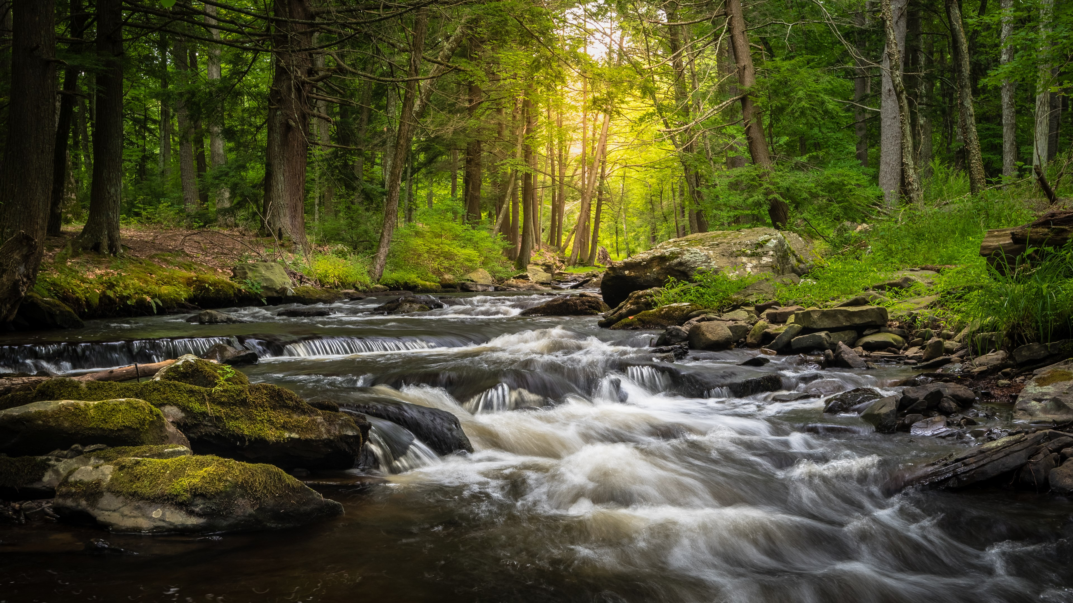
Urban water cycle

Slide 9
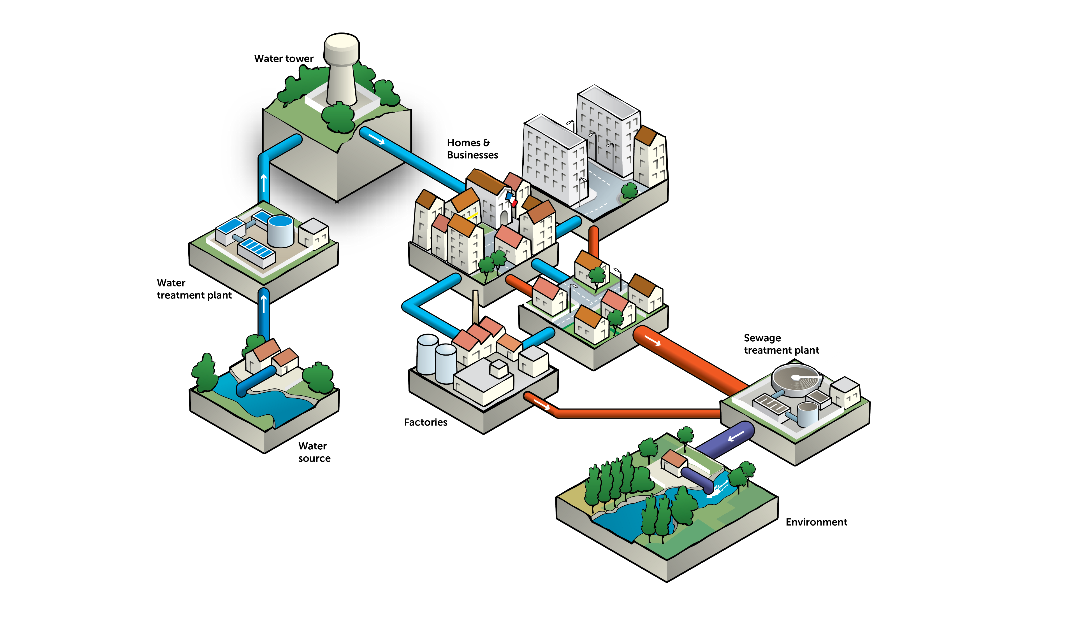
Urban water cycle

Slide 10
Build an urban water network
Show how water goes from the source (river) to your city and back to the environment.

Slide 11
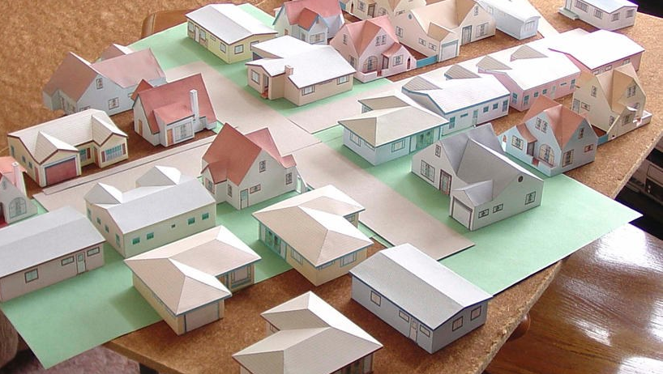
Resources
Water source (river)
Water treatment plant
Water tower
City
Sewage treatment plant
Environment
Notes:
GIS system

Slide 12
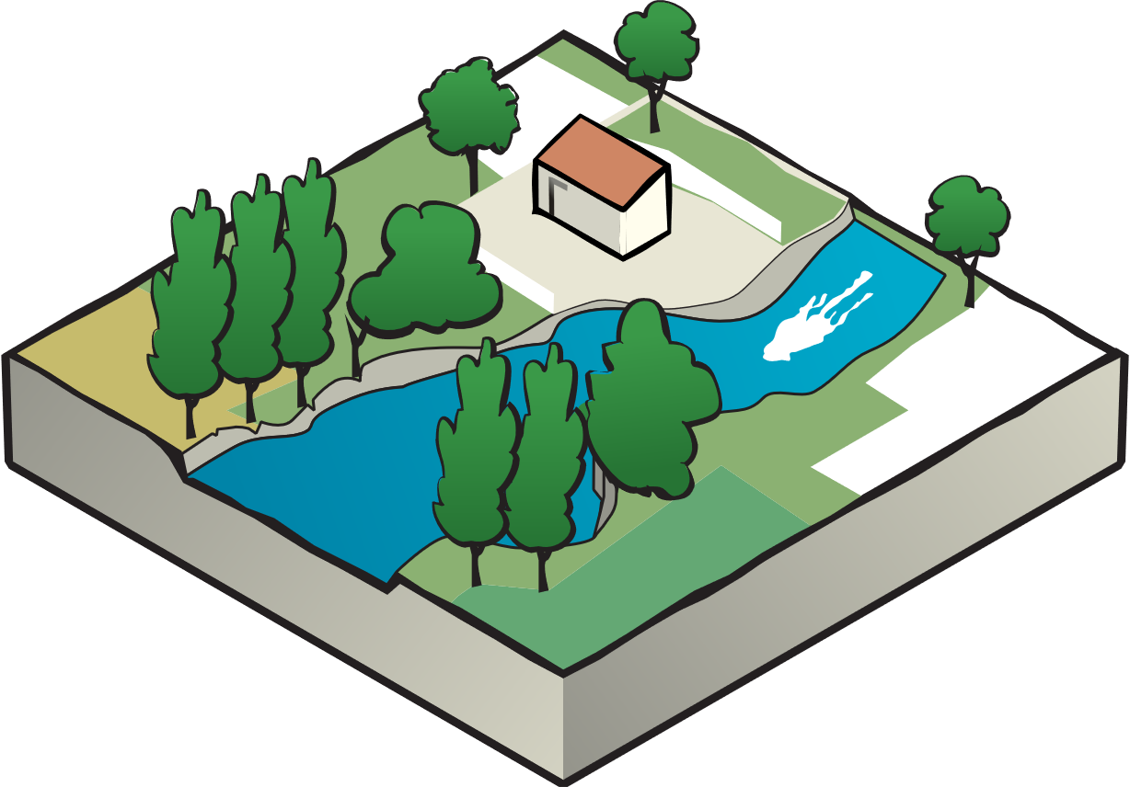
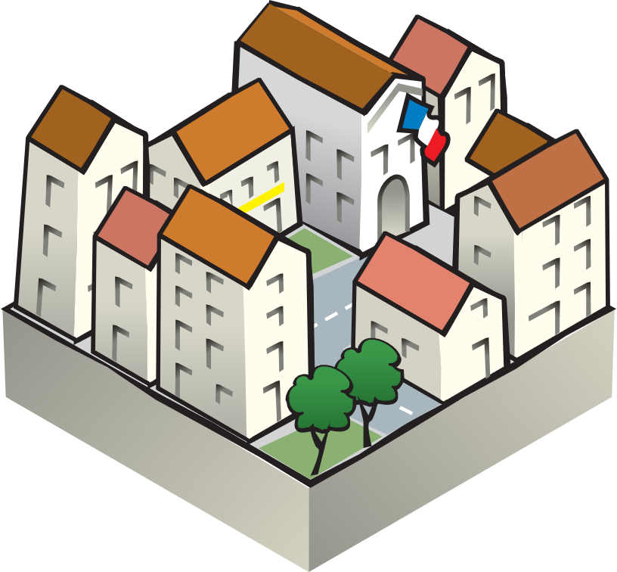
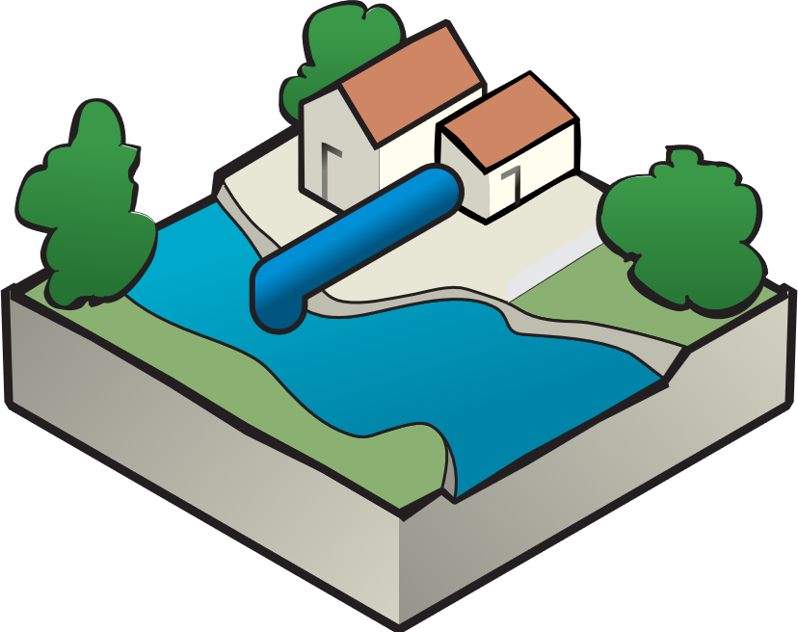
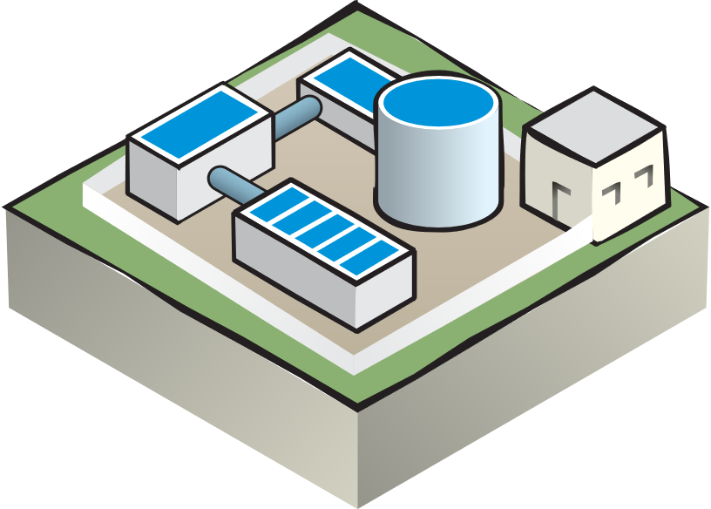
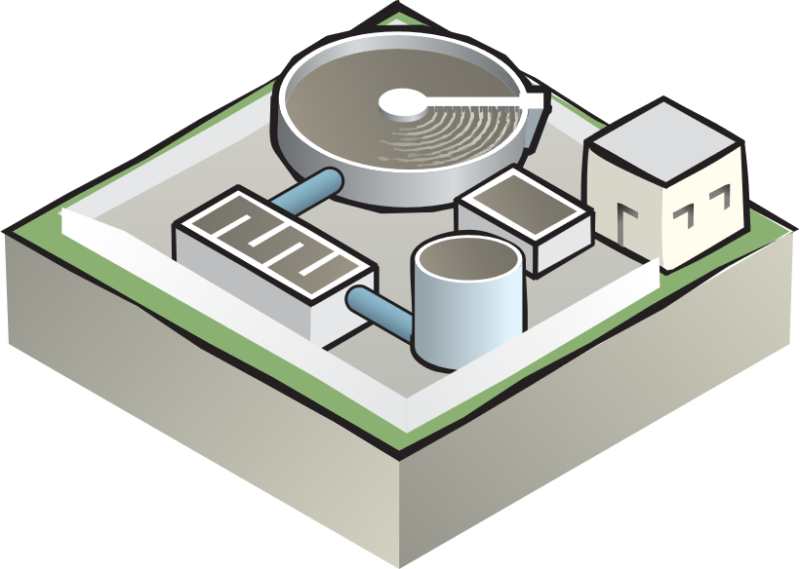

Slide 13
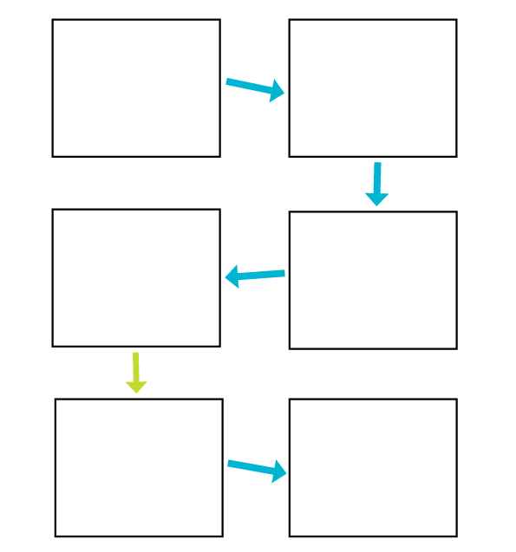
Activity: Urban water cycle flowchart

Slide 14
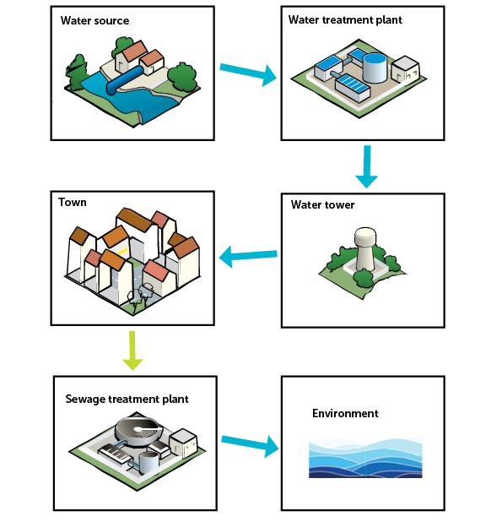
Urban water cycle

Slide 15
You learnt about:
The natural water cycle
Evaporation Condensation
Precipitation Collection
Different water sources and where we can find water
The urban water cycle, how water gets to our taps and where it goes

Slide 16
Any questions?
Find out more at wannonwater.com.au/learn

