Slide 1
Year 7-8: Geography
Urbanisation, water scarcity and wastewater treatment – regional and global perspectives

Slide 2
Notes:
Use this slide if you’d like to share a personalised Acknowledgement of Country

Slide 3
Notes:
Use this slide if you’d like to share a personalised Acknowledgement of Country

Slide 4
About us
Every day, we supply South West Victoria with sustainable water services, while leading our communities towards a healthier, more prosperous future. It’s a commitment that we’re proud to make to the region we call home.
We’re your local, dependable experts
From the South Australian border to the Otways. From the Grampians to the coast. Our services take care of more than 30 communities, including residents, farmers, businesses and industries. It’s our responsibility to supply you with fresh water, from source to tap, and manage sewage to protect your health and wellbeing.
Putting people first comes naturally to us so we’re here to help with more affordable, reliable and personalised service. You’ll see us around, in towns and on streets, maintaining and upgrading the pipes, pump stations and treatment plants we all need.
We’re making a real and positive difference
As locals, we’re driven to shape our region for the better. We’re committed to working with our communities and strategic partners to support the health and wellbeing of our people and protect our natural environment. We simply believe it’s the right thing to do and it all comes back to our greater vision to go beyond water for stronger communities.
It’s about delivering sustainable water services together with positive changer our region – and we’re proud to be leading the way.

Slide 5
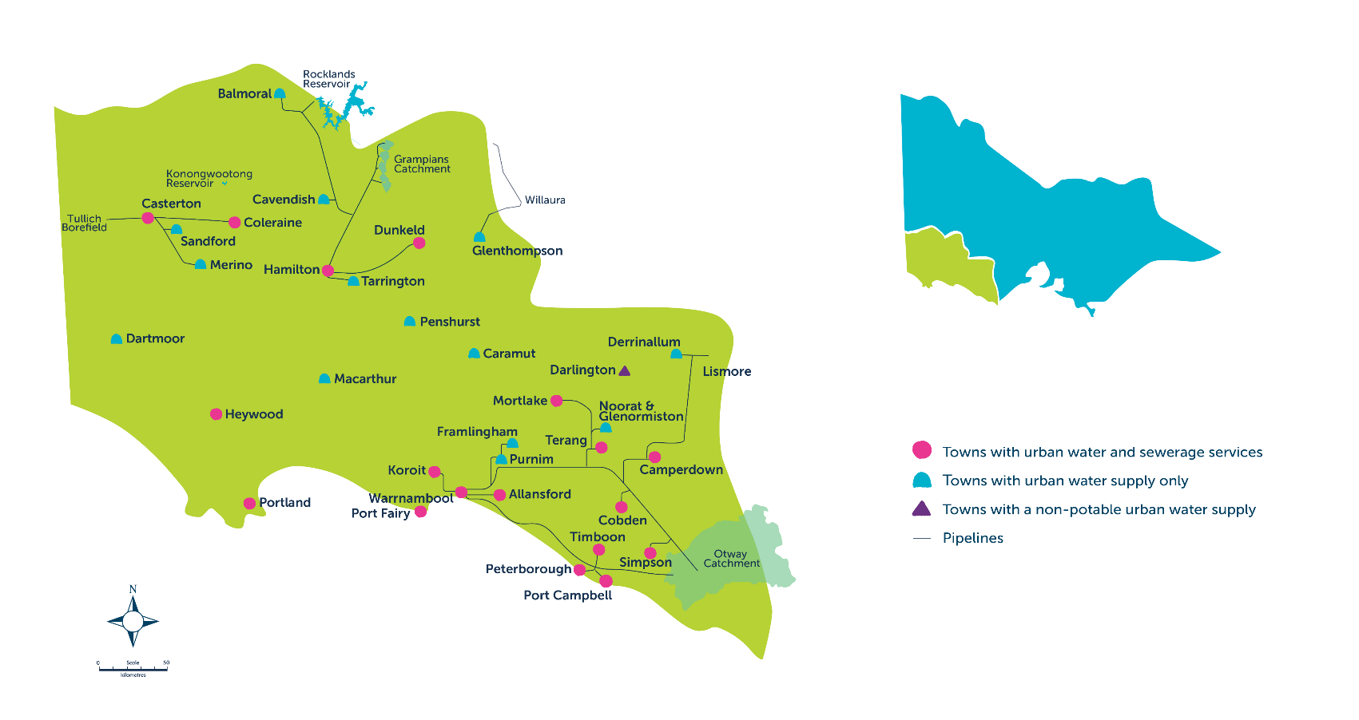
Our region

Slide 6
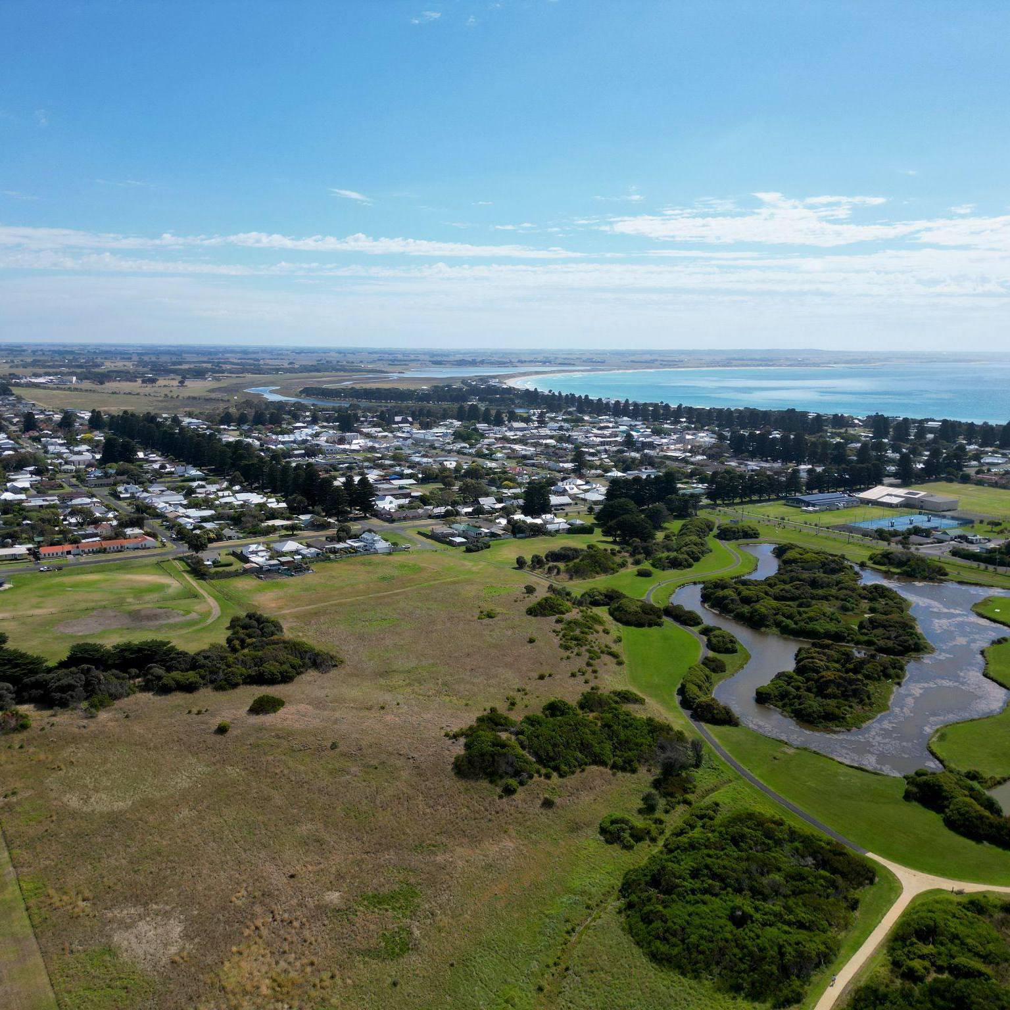
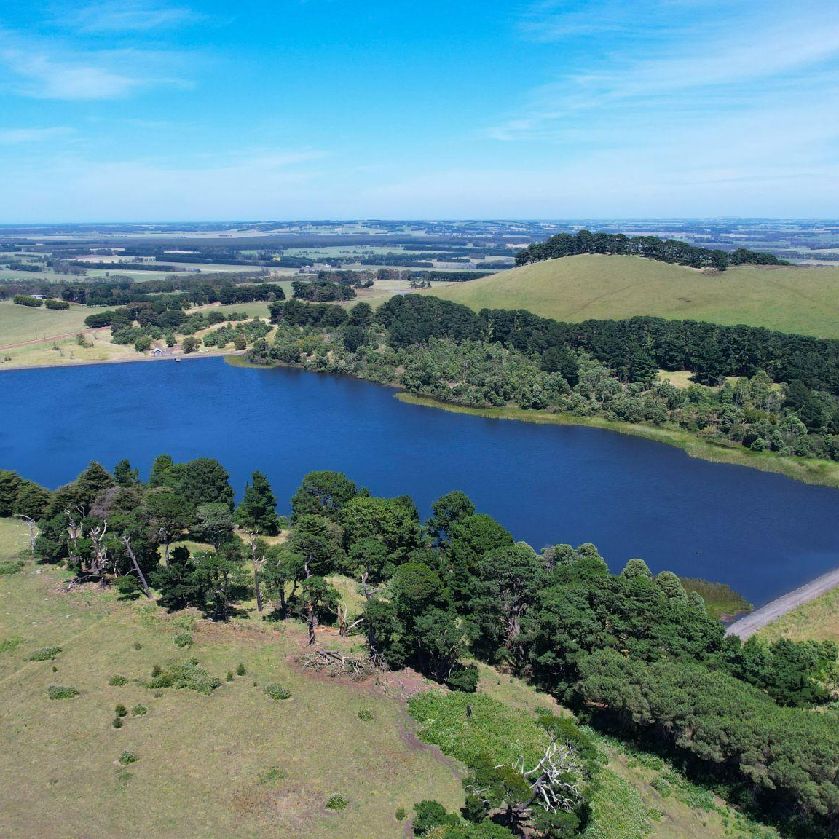
Learning intentions
To examine the global impacts of water scarcity.
To examine how Wannon Water treats wastewater and utilises recycled water in the region.
To research global water innovations that have been designed to reduce water scarcity impacts.

Slide 7
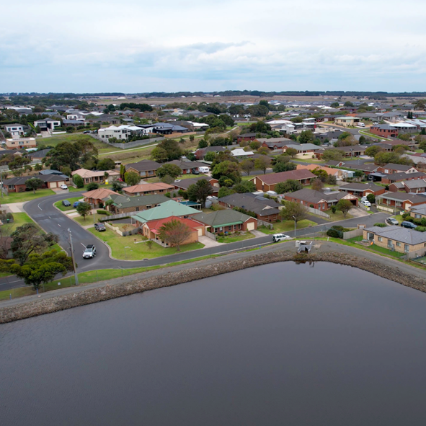
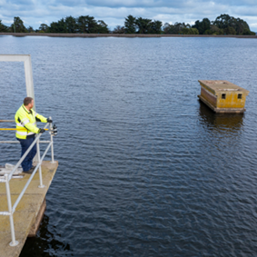
Success criteria
I can understand the causes of water scarcity.
I can compare the rainfall in our region to rainfall in other continents.
I can understand how Wannon Water recycles wastewater.
I can explore global water innovations and explain the key features and benefits of various innovations.

Slide 8
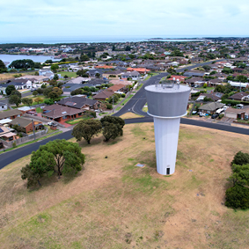
Water scarcity – what is it?
Water can be scarce for many reasons: demand for water may be exceeding supply, water infrastructure may be inadequate, or institutions may be failing to balance everyone’s needs.
Water scarcity is an increasing problem on every continent, with poorer communities most adversely affected. To build resilience against climate change and to serve a growing population, an integrated and inclusive approach must be taken to managing this finite resource (water).
Credit: www.unwater.org/water-facts/water-scarcity

Slide 9
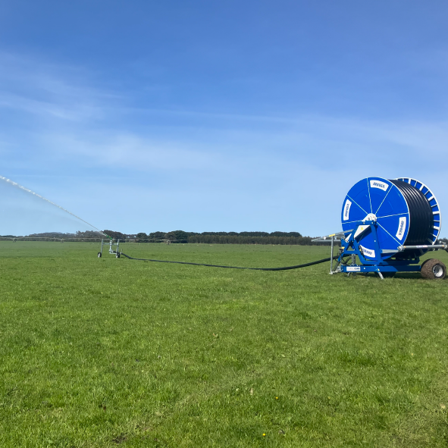
Wastewater can be treated and used as a resource…
One solution to water scarcity is to utilise wastewater as a valuable water resource.
Wastewater needs to be effectively treated before it can be used as a resource.

Slide 10
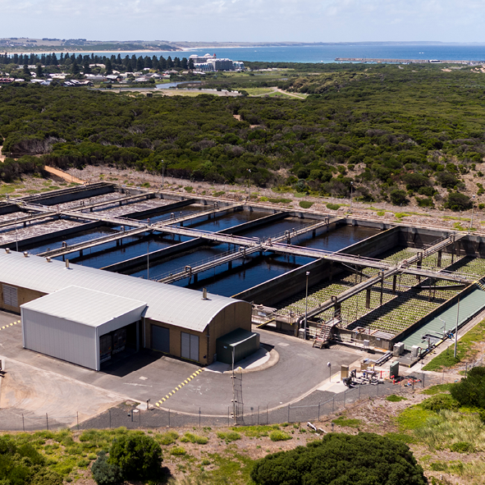
How is recycled wastewater used in the Wannon Water region?
Firstly, wastewater needs to be treated.
Urbanisation and population growth result in an increase in wastewater…

Slide 11
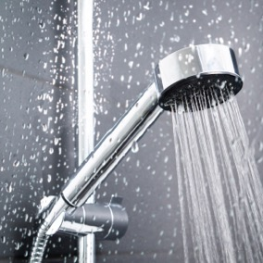
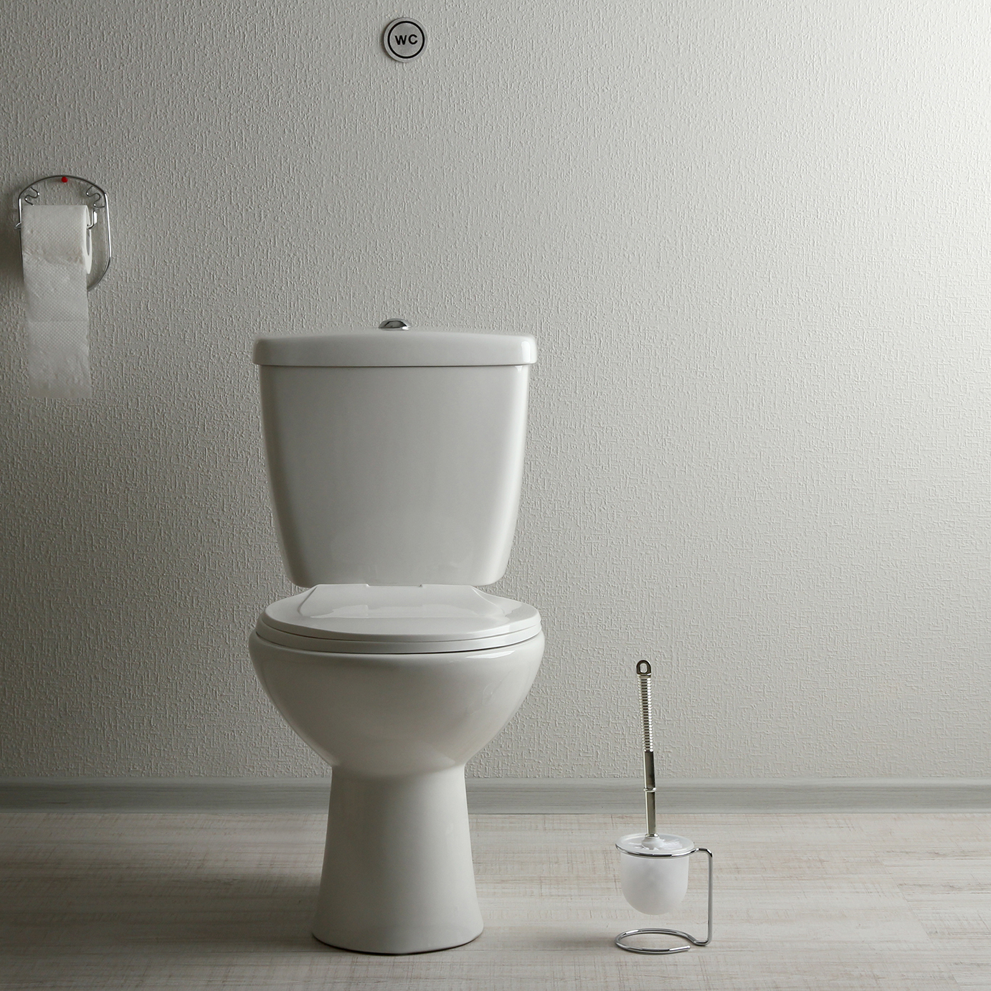
When you flush the toilet, have a shower or wash your car, do you know where this wastewater goes?
Known as sewage, it must be correctly treated
so it doesn’t pose a danger to public health
or the environment. And that’s where
Wannon Water comes in…

Slide 12
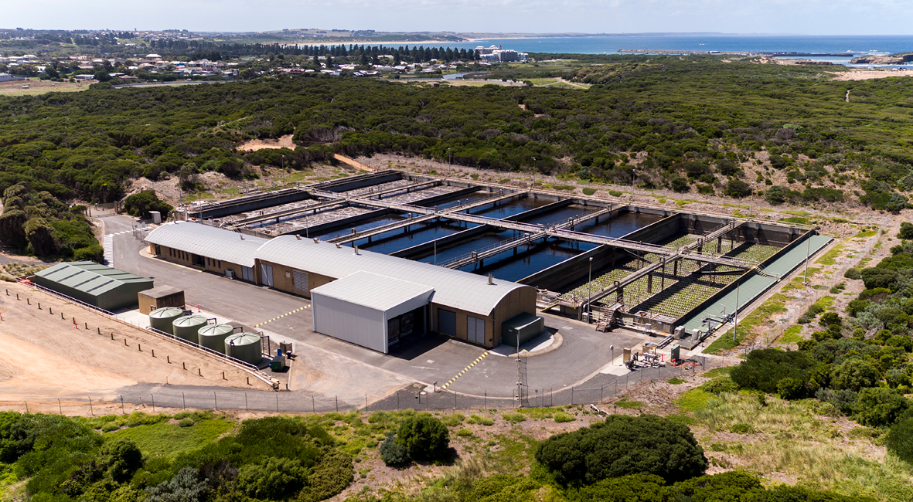
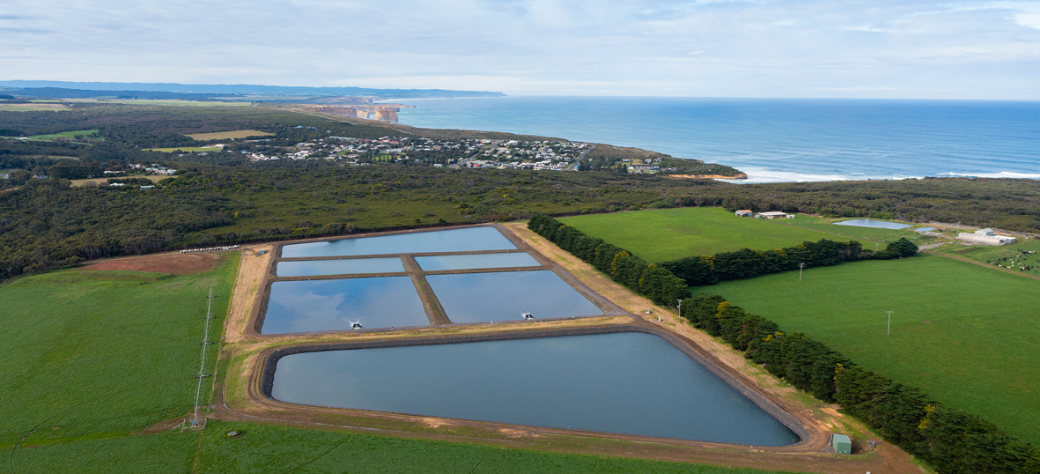
In our region, wastewater is treated in a number of ways…
Sewage Treatment Plants (STP)
Warrnambool Sewage Treatment Plant
Inland Lagoon Systems

Slide 13
STPs
Depending on where you live in the Wannon Water region, your sewage may be treated by one of the below;
View the region map online
Inland Lagoon Sewage System
Warrnambool Sewage Treatment Plant
The following 13 towns are serviced by their own inland lagoon sewage treatment system: Camperdown, Casterton, Cobden, Coleraine, Dunkeld, Hamilton, Heywood, Mortlake, Peterborough, Port Campbell, Simpson, Terang and Timboon.
Warrnambool, Allansford and Koroit are serviced by the Warrnambool Sewage Treatment Plant, located near the coast north-west of Thunder Point.

Slide 14
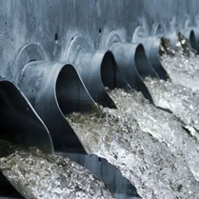
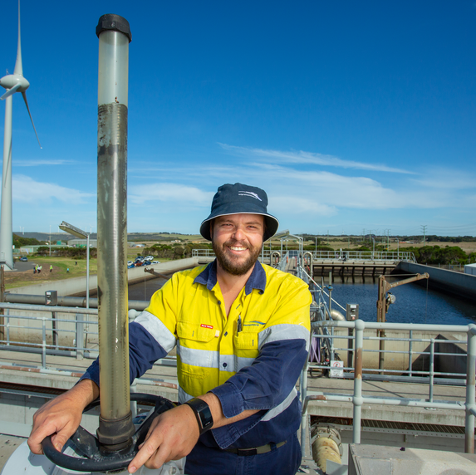
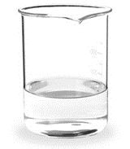
What is sewage?
Did you know?
Sewage actually consists of around 99.6 percent water.
The remainder is made up of mostly biodegradable pollutants and small solid particles.

Slide 15
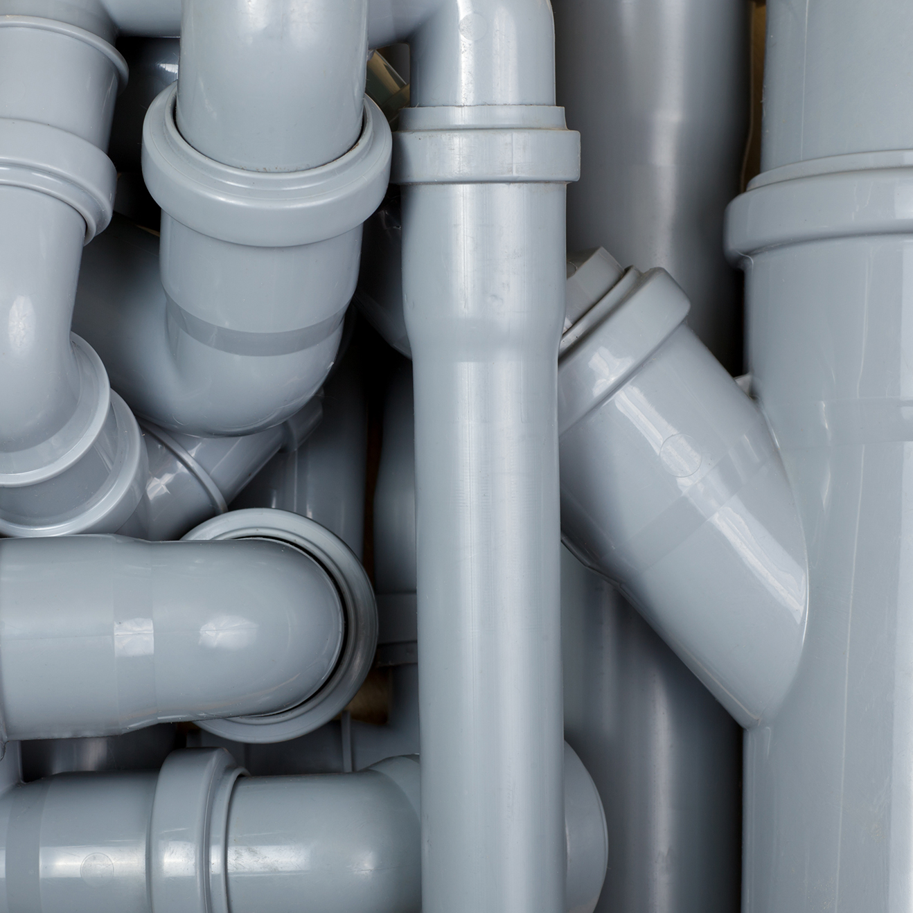
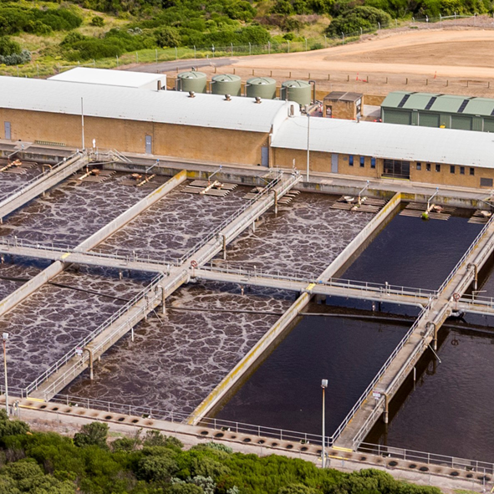
How does sewage get to the plant?
Sewage from your bathroom, toilet, sinks and drains, and from industry, is collected in underground pipes.
It then flows to larger pipes called sewers, which are generally situated along the back boundaries of properties.
Sewers generally slope downwards to allow the sewage to flow to the plant by gravity.

Slide 16
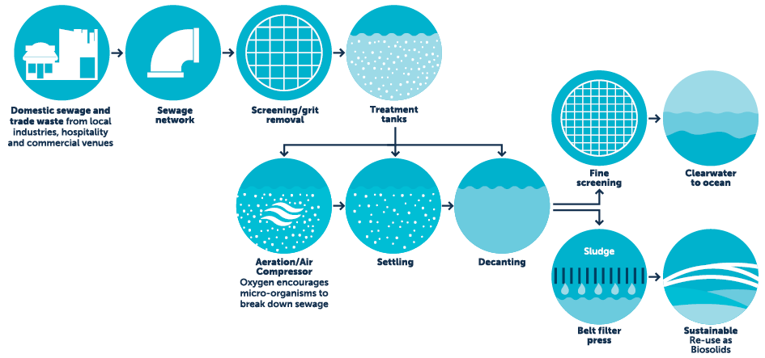
How does the treatment process work?
Warrnambool
Sewage Treatment Plant
3
4
1
2
5

Slide 17
1. Once sewage reaches the STP, any larger items, rubbish and grit is screened out of the sewage and sent to landfill.
2. The sewage is then treated in large tanks where naturally-occurring bacteria and micro-organisms use it as a food source, breaking down any solids.
3. This process uses cycles of aeration to treat the sewage before it settles.
The treated water is decanted from the surface of the tank.
4. It then travels through another screening system before being discharged to the ocean.
5. Sludge is removed from the bottom of the tank and excess water is removed.
The dried sludge is then transported offsite and stabilised in drying beds for several years before it can be re-used on farms as a soil conditioner, known as bio-solids.

Slide 18
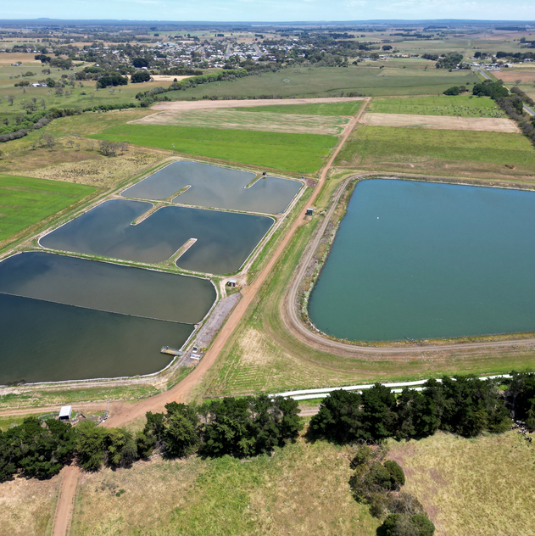
Lagoon based treatment plants
All our other inland sewerage systems use lagoon-based treatment, which is essentially the same as Steps 4 and 5 of the biofiltration treatment process. Sewage from these towns flows to a primary lagoon where bacteria consume any remaining organic matter.
After this primary treatment, the water flows to a maturation lagoon to settle, with sunlight (UV rays) killing harmful bacteria over time.

Slide 19
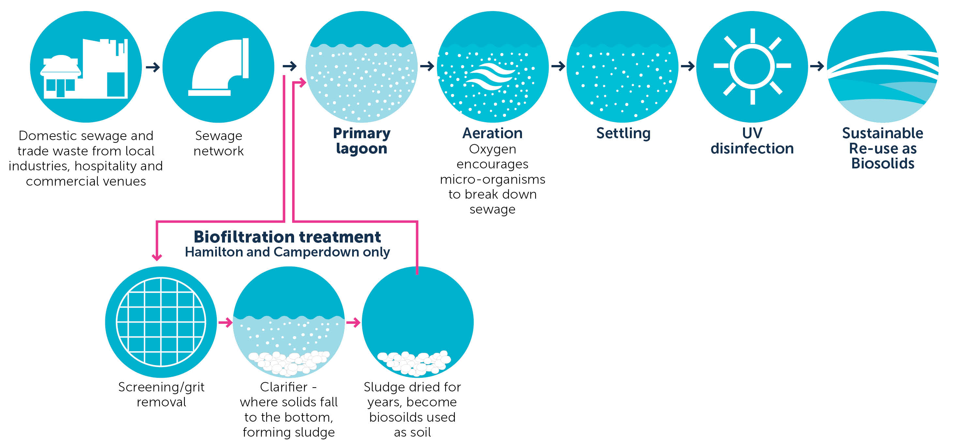
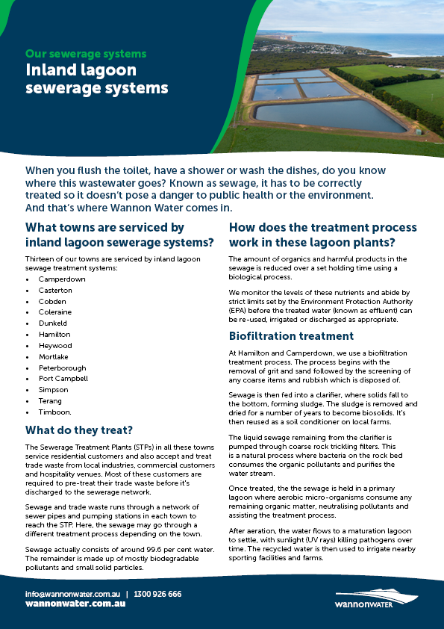
How does the lagoon treatment process work?
Download the information sheet
Inland Lagoon Sewage System

Slide 20
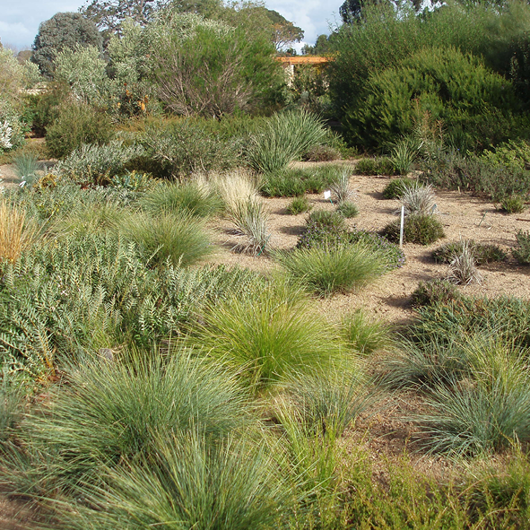
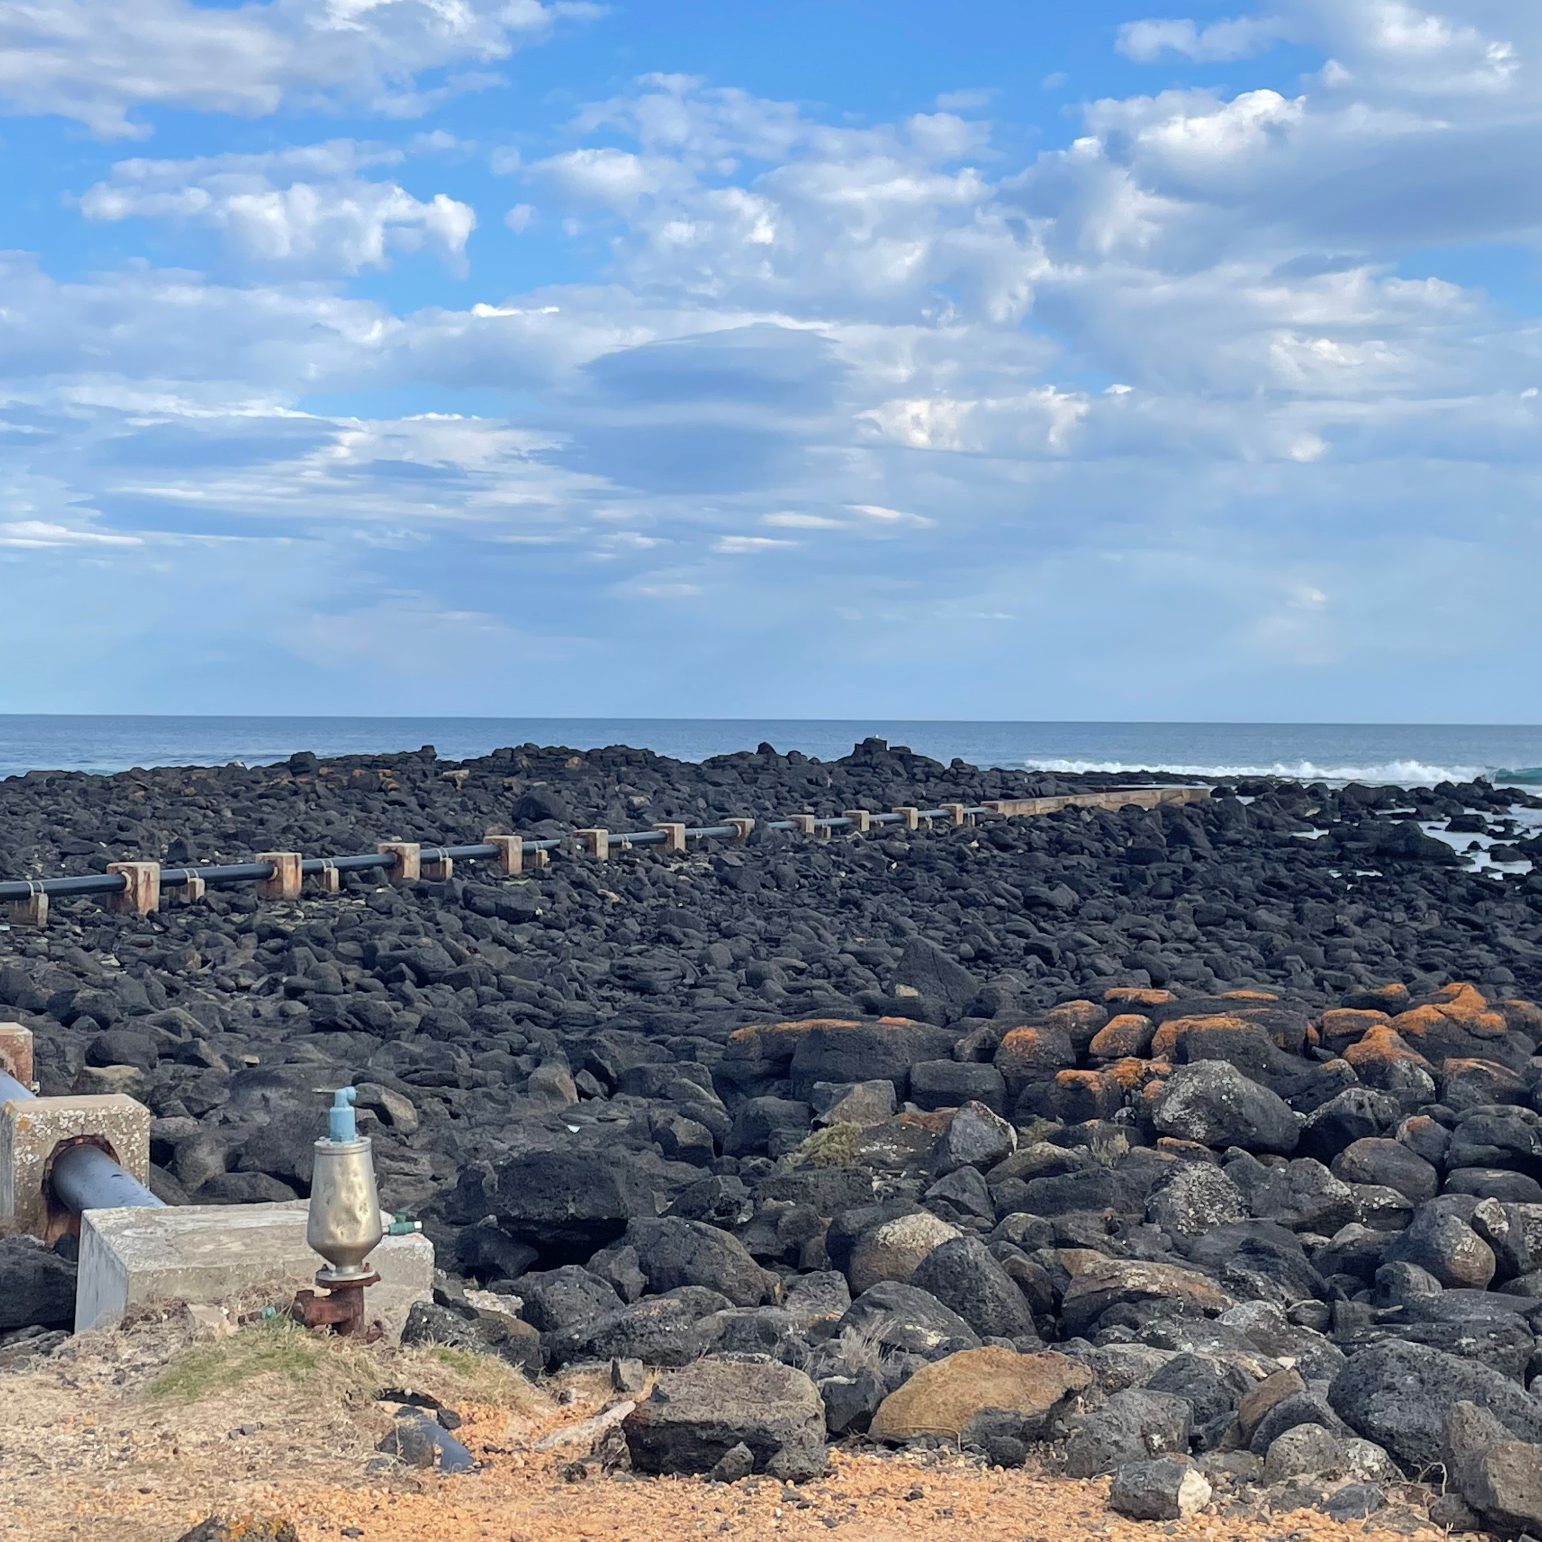
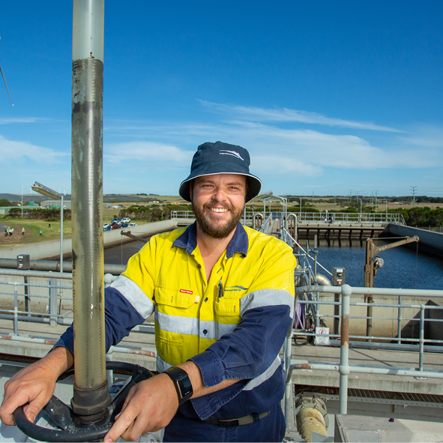
What happens to the treated water?
All our other inland sewerage systems use lagoon-based treatment, which is essentially the same as Steps 4 and 5 of the biofiltration treatment process.
Sewage from these towns flows to a primary lagoon where bacteria consume any remaining organic matter.
After this primary treatment, the water flows to a maturation lagoon to settle, with sunlight (UV rays) killing harmful bacteria over time.

Slide 21
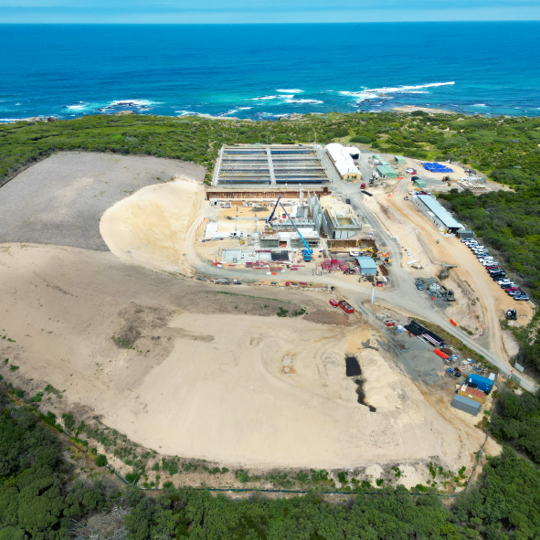
Could the effluent be recycled for other uses?
One of Wannon Water’s main functions is to develop and implement programs for the recycling and reuse of effluent.
Wannon Water is currently investigating recycled water opportunities at the Warrnambool Sewage Treatment Plant.
Because of our region’s sufficient and reliable rainfall, Wannon Water currently only recycles around 15 - 20% of the effluent produced in the region.
There is a limited market for use of recycled water as we have sufficient and reliable rainfall for our current population needs.

Slide 22
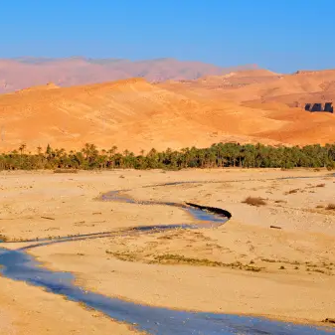
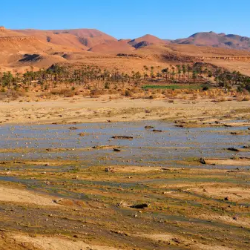
Water Scarcity - global perspectives
Some areas of our world have much lower rainfall than our region and therefore they need to use water and wastewater very carefully to ensure water security.
Compare and discuss the following rainfall data…
Mean annual rainfall:
Warrnambool - 743 mm
Casterton - 655 mm
China - 645 mm
Iraq - 213 mm
Egypt - 200 mm
Bahrain - 80 mm
Algeria - 59 mm
Algeria Desert

Slide 23
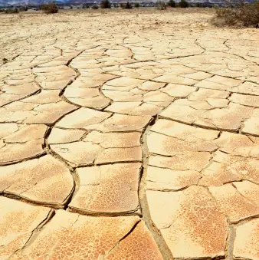
Regions with low annual rainfall rely on innovative solutions to ensure water security…
…it is predicted that by 2025, most countries in West Asia and Africa will face severe water scarcity due to increasing population and demands on water.
Credit: wwf.panda.org/discover/knowledge_hub/teacher_resources/webfieldtrips/water
Eastern Desert, Egypt

Slide 24
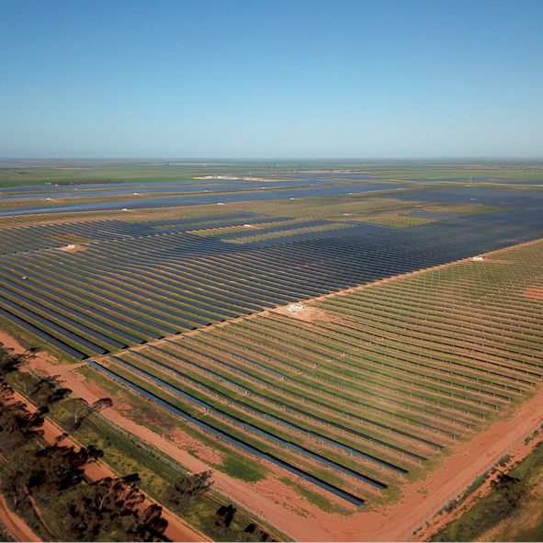
Research task
Innovators around the world are coming up with solutions to ensure water security into the future.
Your task
Research one global water innovation using one of the provided website links (see Slide 27).
Choose from the activity menu, outline the key features and benefits of the water innovation you research to share with your teacher/class.

Slide 25
Research task activity menu
Use the links on the following slide to assist your research and innovation.
1. Create an advertisement to sell the innovation to an entrepreneur. Outline the key features and benefits of the innovation. | 2. Write a persuasive letter to sell the innovation to the World Health Organisation. Outline the key features and benefits of the innovation.
3. Film a news story/interview, outlining the key features and benefits of the innovation. | 4. Design a new innovation to support communities experiencing water scarcity. Design using a labelled diagram and outline the key features and benefits.

Slide 26
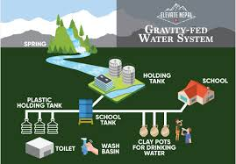
Innovation example
Gravity fed water supply system in Nepal
In Nepal, in 2025, an earthquake damaged many water sources in rural villages located in the mountains, like in Dhading district. The earthquake caused the underground water supply to move and communities’ existing water supplies to completely dry up. People were forced to leave their homes due to the lack of access to water.
Solution
To bring water back to the community in an even more accessible way, Oxfam built a gravity water supply system to support 266 households (1,500 people), as well as three schools. Taps are connected to their homes and women no longer have to go and collect water as they did before the earthquake.
Credit: www.oxfam.org/en/innovation-meets-expertise-oxfams-clean-water-projects-around-world
Questions to discuss/consider
What are the key features?
What are the key benefits?
How could you outline these in your research task?

Slide 27
Global water security innovations
Links for research
National Geographic
www.nationalgeographic.com/environment/article/partner-content-how-australia-is-securing-its-water-future
UN
www.un.org/en/climatechange/science/climate-issues/water?gclid=Cj0KCQiA4NWrBhD-ARIsAFCKwWuLdQ1NqAdFpHaBoSbv_wv3E45LJgrjVSgGyEwjLRiWumyesGXR18waAlFyEALw_wcB
https://www.unwater.org/water-facts
World Future Energy Summit https://www.worldfutureenergysummit.com/en-gb/future-insights-blog/overcoming-the-imminent-water-crisis--global-innovations-and-technology-breakthroughs-.html
Oxfam
www.oxfam.org/en/innovation-meets-expertise-oxfams-clean-water-projects-around-world
World Bank
https://blogs.worldbank.org/water/water-security-underpins-indonesias-vision-2045

Slide 28
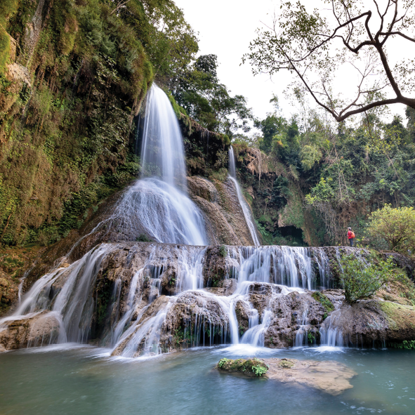
Share and reflect
Students share their water scarcity innovation research tasks
Discuss - how can we have a positive impact as global citizens now and into the future…

Slide 29
Extension opportunities
Research: Wannon Water’s Reverse Osmosis Treatment Plant Quality Water for Wannon - Wannon Water > Explore the Portland, Port Fairy and Heywood information pages. > Read through the FAQs.
> Record a summary of information about Reverse Osmosis Water treatment, how it will improve water quality and taste and where/how it will be delivered in our region. Can you find anywhere else in Australia/the world that uses Reverse Osmosis Water treatment?
Creative task: Imagine - climate change has created drought conditions in the Wannon Water region. Using your research of the various water innovations around the world, create a plan to provide sufficient water to the communities of the region.
Extension research about water scarcity: Examine the UN website to learn more about the global impacts of water scarcity www.unwater.org/water-facts/water-scarcity

