Slide 1
Year 7-8: Geography
Water catchment, treatment
and supply in our region

Slide 2
Notes:
Use this slide if you’d like to share a personalised Acknowledgement of Country

Slide 3
Notes:
Use this slide if you’d like to share a personalised Acknowledgement of Country

Slide 4
About us
Every day, we supply South West Victoria with sustainable water services, while leading our communities towards a healthier, more prosperous future. It’s a commitment that we’re proud to make to the region we call home.
We’re your local, dependable experts
From the South Australian border to the Otways. From the Grampians to the coast. Our services take care of more than 30 communities, including residents, farmers, businesses and industries. It’s our responsibility to supply you with fresh water, from source to tap, and manage sewage to protect your health and wellbeing.
Putting people first comes naturally to us so we’re here to help with more affordable, reliable and personalised service. You’ll see us around, in towns and on streets, maintaining and upgrading the pipes, pump stations and treatment plants we all need.
We’re making a real and positive difference
As locals, we’re driven to shape our region for the better. We’re committed to working with our communities and strategic partners to support the health and wellbeing of our people and protect our natural environment. We simply believe it’s the right thing to do and it all comes back to our greater vision to go beyond water for stronger communities.
It’s about delivering sustainable water services together with positive changer our region – and we’re proud to be leading the way.

Slide 5
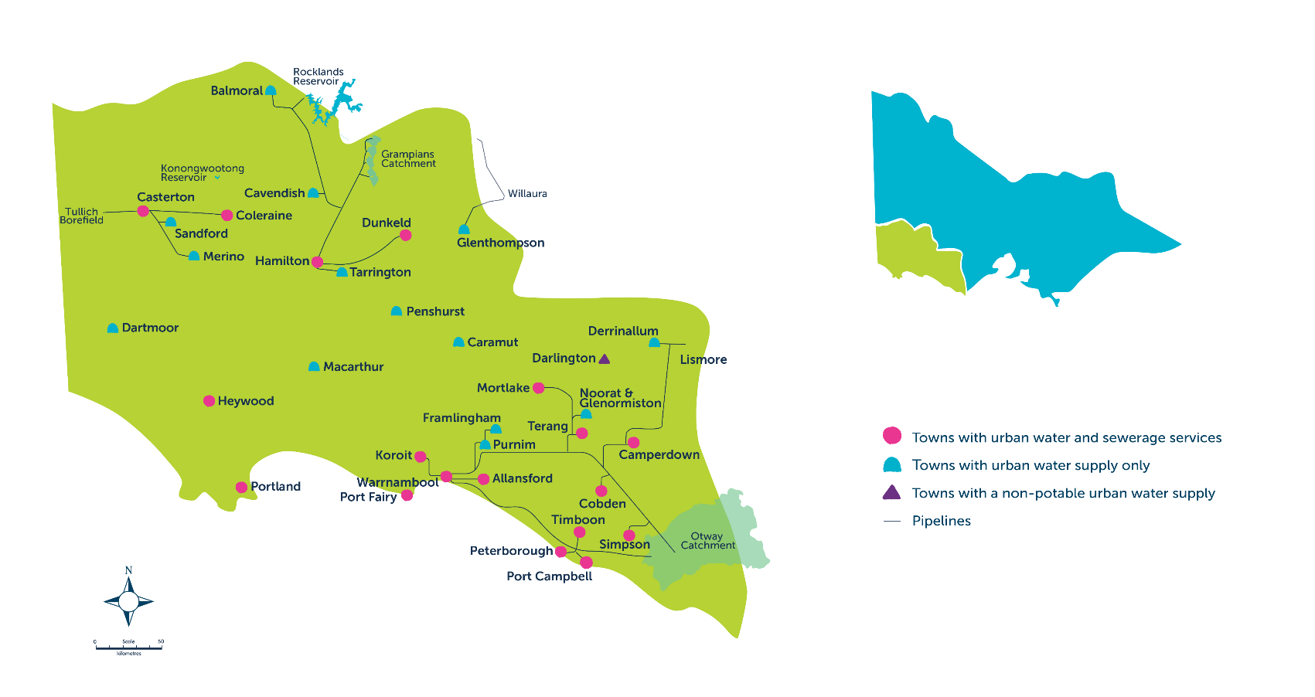
Our region

Slide 6
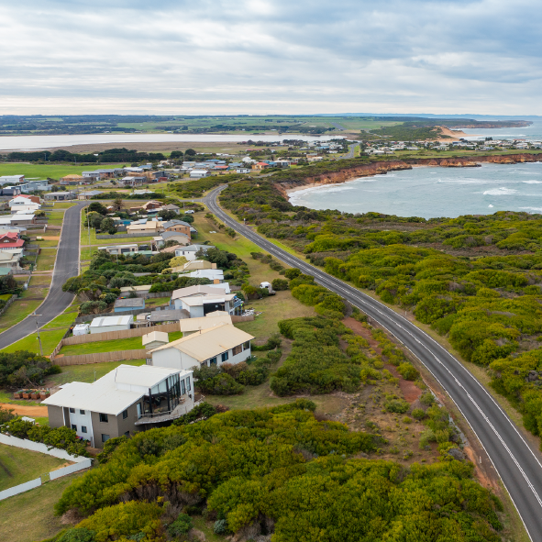
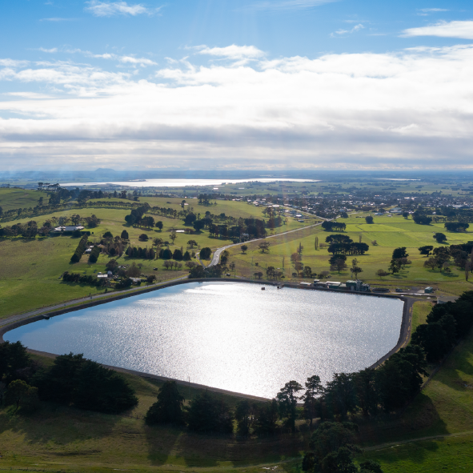
Learning intentions
To explore the various water sources in our region.
To research how water is treated and stored in our region.
To summarise key information about the movement of water in the local water sources.

Slide 7
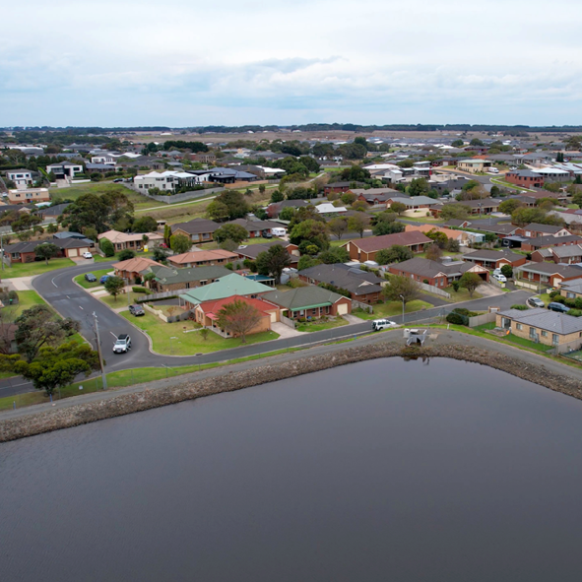
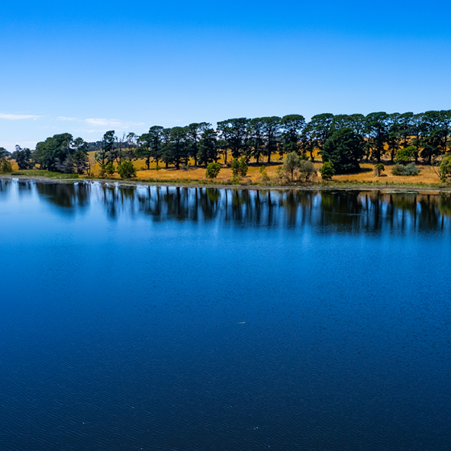
Success criteria
I can understand that we have multiple water supplies in our region.
I can research how water moves in one of the water supplies/sources in our region.
I can present my research to my class/small group.

Slide 8
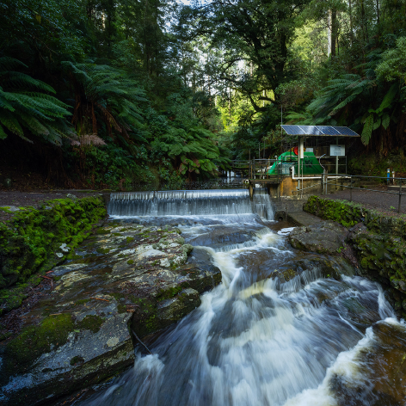
Class discussion
How does water move through our environment?

Slide 9
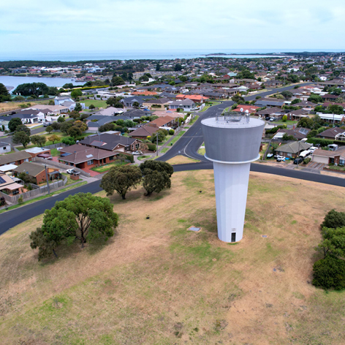
Secondary Activity: 7-8
Observe and discuss the Natural Water Cycle and Urban Water Cycle diagrams on the following slides…

Slide 10
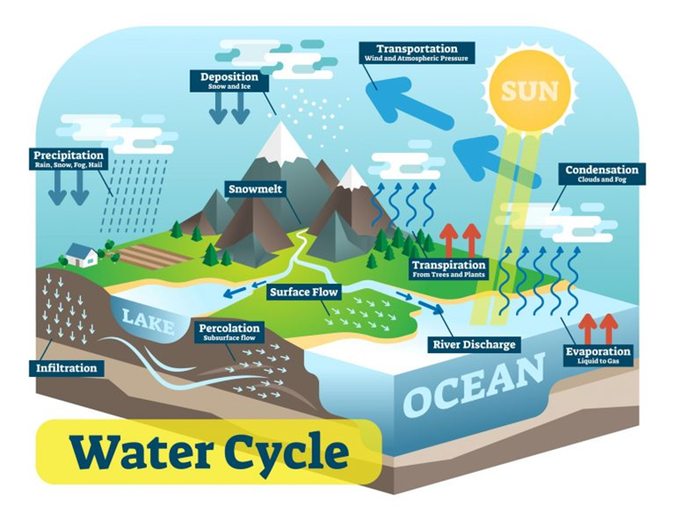
Natural Water Cycle
To be updated with new diagrams once completed

Slide 11
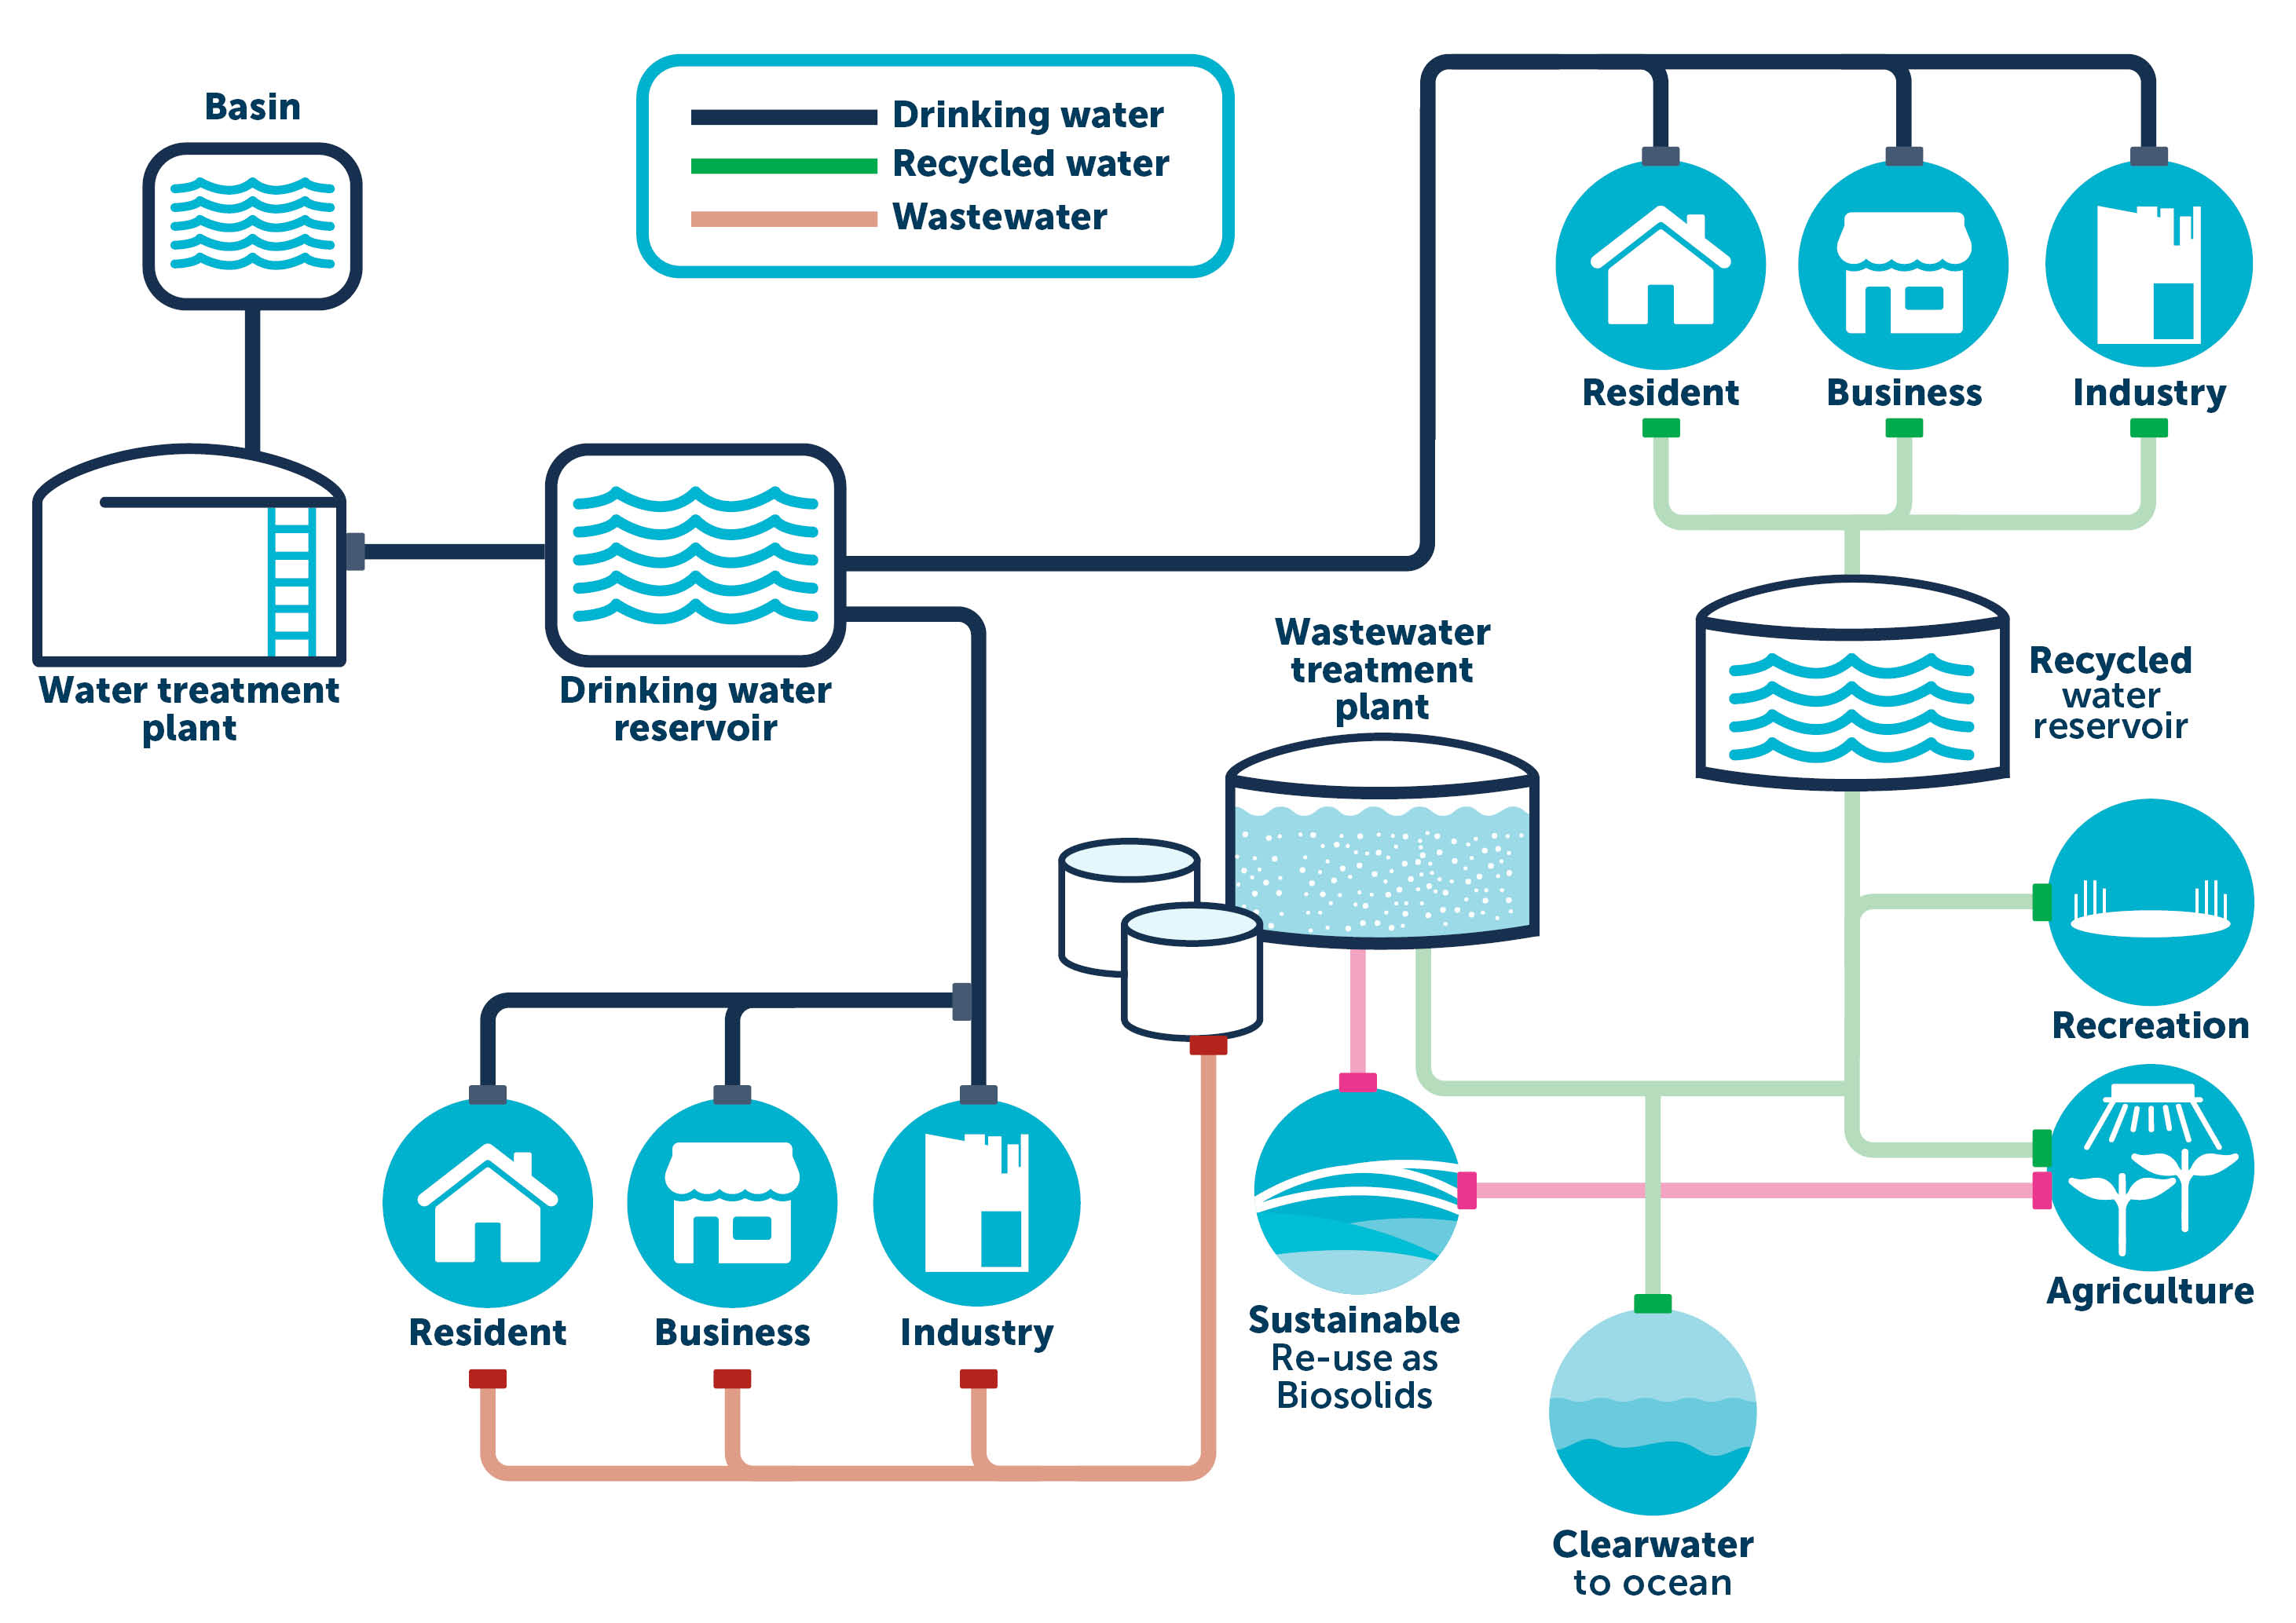
Urban
Water
Cycle

Slide 12
Natural Water Cycle vs Urban Water Cycle
What do you notice when comparing?
To be updated with new diagrams once completed

Slide 13
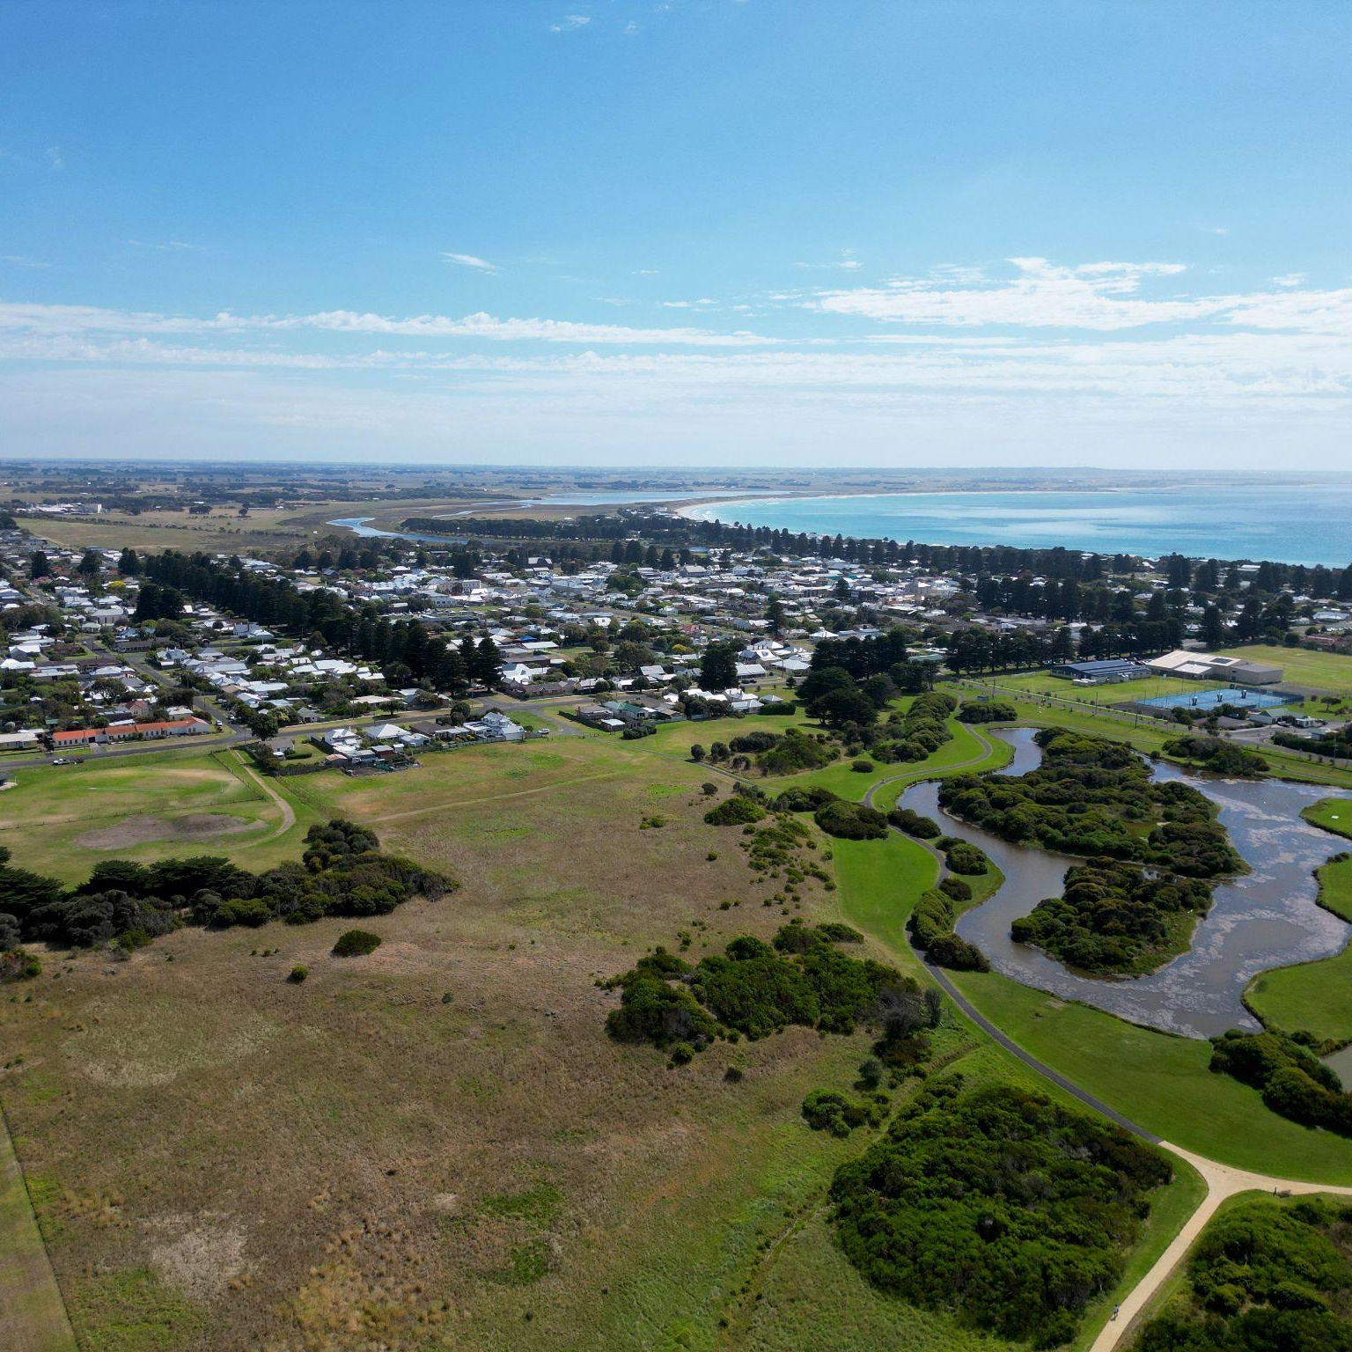
What do you understand now, after viewing both diagrams?
What is urbanisation?
What are the similarities and differences between the Natural Water Cycle and Urban Water Cycle?
How has urbanisation impacted on the Water Cycle?

Slide 14
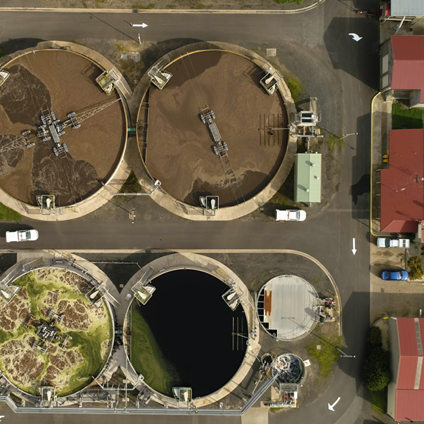
Small group research task
Introduction
We will research the movement, treatment and supply of water in our region.
Discuss - why does our region need multiple water source/supply areas?
Optional - explore the Wannon Water region using Google Maps - what do you observe?
Notes:
Discuss and highlight the vast and varied types of communities and natural environments in our region, e.g., farming, small rural towns, regional cities, regional centres, natural environments, e.g., forests, rivers, lakes, streams, national parks, etc.

Slide 15
Task
Read the Wannon Water supply factsheets (see Slide 16 for options) to research water catchment, treatment and supply in our region.
Record your findings in our printable/downloadable Student research PowerPoint template
Students to work in mixed ability groupings
(use the jigsaw grouping method - outlined on Slide 18)

Slide 16
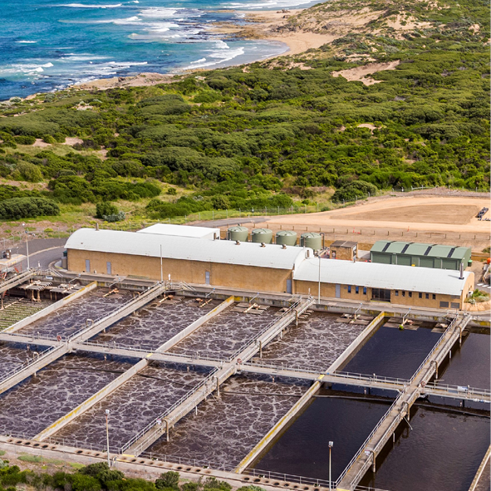
Region factsheets
Casterton, Coleraine, Sandford and Merino’s water source
Grampians Water Supply System
Otway Water Supply System
Port Campbell, Peterborough and Timboon’s water source
Portland, Port Fairy, Heywood and Dartmoor’s water source

Slide 17
Example factsheet
Note - all factsheets include:
Subheadings
Water source
Treatment process

Slide 18
Group | Casterton, Coloraine, Sandford & Merino | Grampians | Otway | Port Campbell, Peterborough & Timboon | Portland, Port Fairy, Heywood & Dartmoor
1
2
3
4
5
Notes:
Create groups of 5 students.
Within each group, allocate a different water source/supply to each member of the group.
Students will move off to work with students from the other groups who have been allocated the same water supply. Aim for mixed ability groupings to assist in reading and comprehending the information sheets
Once research is complete, each student moves back to their original Jigsaw group of 5 to present their research.

Slide 19
Task
In your group, read carefully through the factsheet for your region.
Work together to summarise the information in your own words.
Use the Wannon Water Student research PowerPoint template to record your summary.

Slide 20
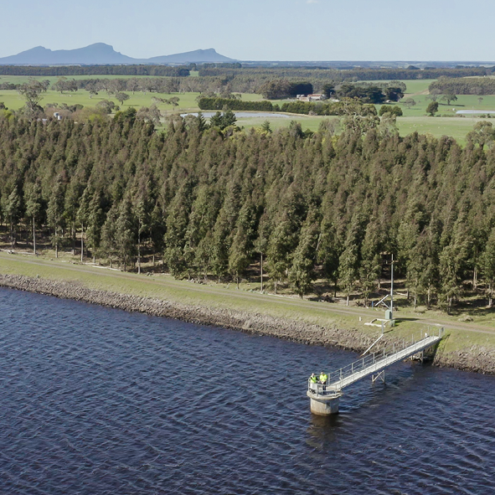
Presentation
Return to your Jigsaw groups.
Each member presents their findings to their group - remember active listening!
Aim for 3 minutes per student.

Slide 21
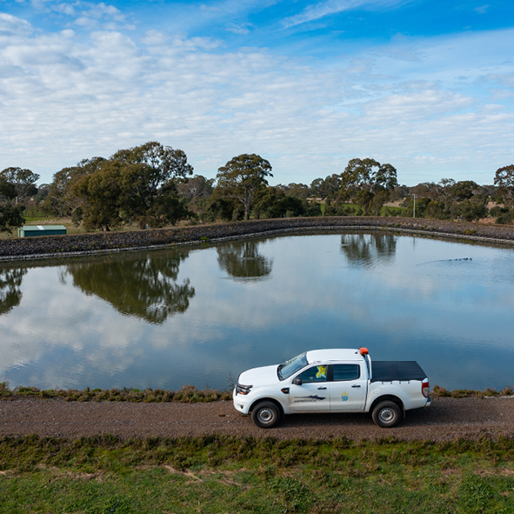
Reflection
What are the similarities/differences between the water supply areas in our region?
During your research, did you notice anything that might pose a challenge for residents in our region?
During your research, did you notice anything that might pose a challenge for organisations that manage water in our region?

Slide 22
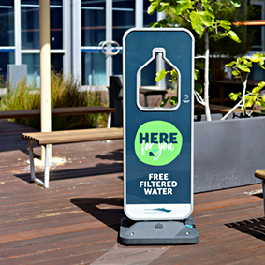
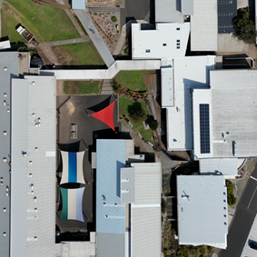
Extension opportunities
Explore sustainable water innovations in our region
Refer to Wannon Water website links:
Projects and initiatives - Wannon Water
Records flow from Warrnambool's roof waterharvesting system - Wannon Water
Brierly Basin floating solar array - Wannon Water

