Slide 1
Year 9-10: Geography
Sustainable ecosystem services and
Integrated Water Management

Slide 2
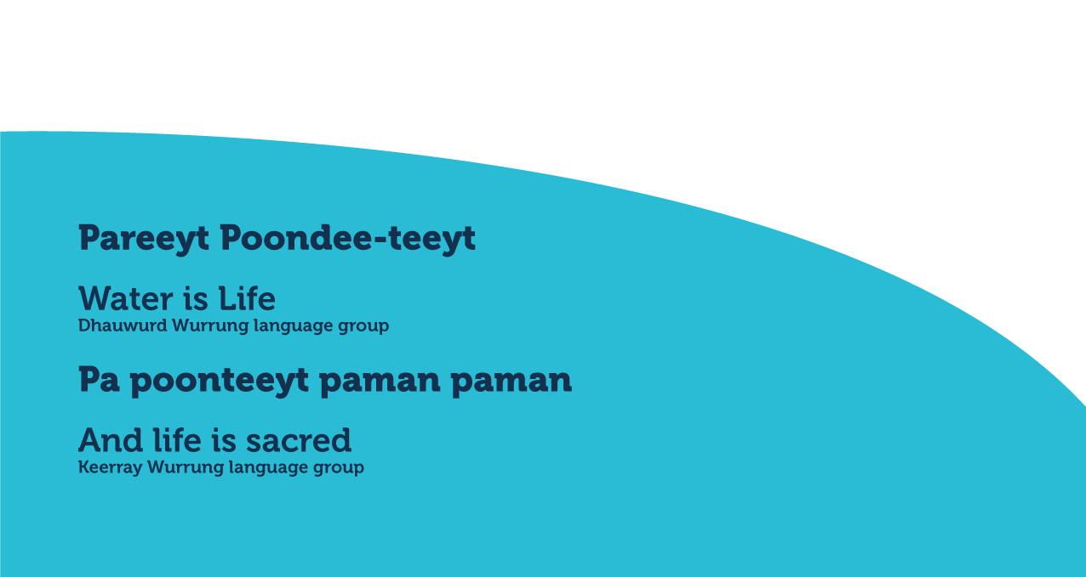
Notes:
Use this slide if you’d like to share a personalised Acknowledgement of Country

Slide 3
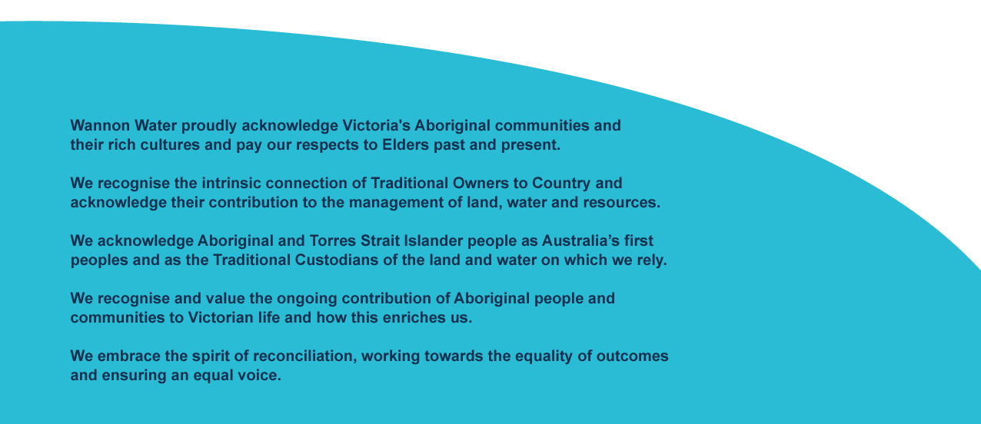
Notes:
Use this slide if you’d like to share a personalised Acknowledgement of Country

Slide 4
About us
Every day, we supply South West Victoria with sustainable water services, while leading our communities towards a healthier, more prosperous future. It’s a commitment that we’re proud to make to the region we call home.
We’re your local, dependable experts
From the South Australian border to the Otways. From the Grampians to the coast. Our services take care of more than 30 communities, including residents, farmers, businesses and industries. It’s our responsibility to supply you with fresh water, from source to tap, and manage sewage to protect your health and wellbeing.
Putting people first comes naturally to us so we’re here to help with more affordable, reliable and personalised service. You’ll see us around, in towns and on streets, maintaining and upgrading the pipes, pump stations and treatment plants we all need.
We’re making a real and positive difference
As locals, we’re driven to shape our region for the better. We’re committed to working with our communities and strategic partners to support the health and wellbeing of our people and protect our natural environment. We simply believe it’s the right thing to do and it all comes back to our greater vision to go beyond water for stronger communities.
It’s about delivering sustainable water services together with positive changer our region – and we’re proud to be leading the way.

Slide 5
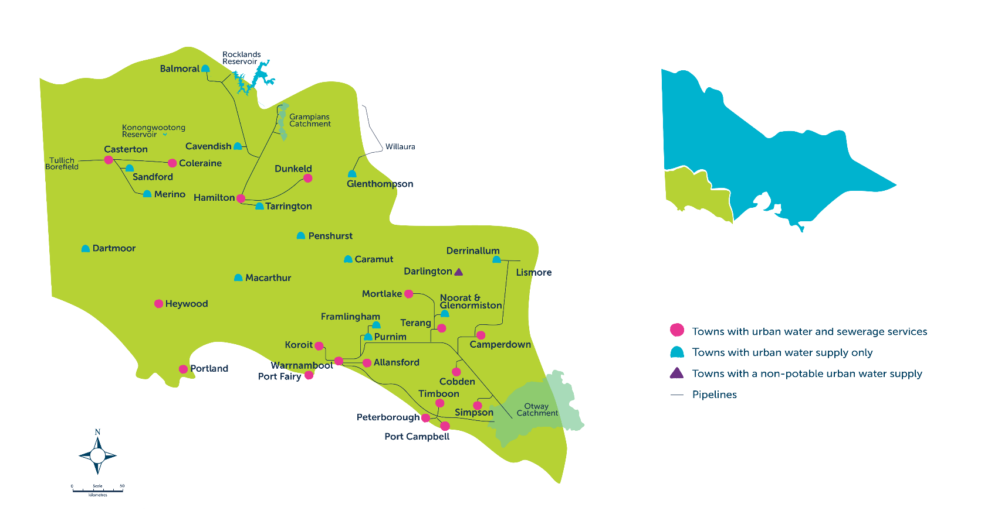
Our region

Slide 6
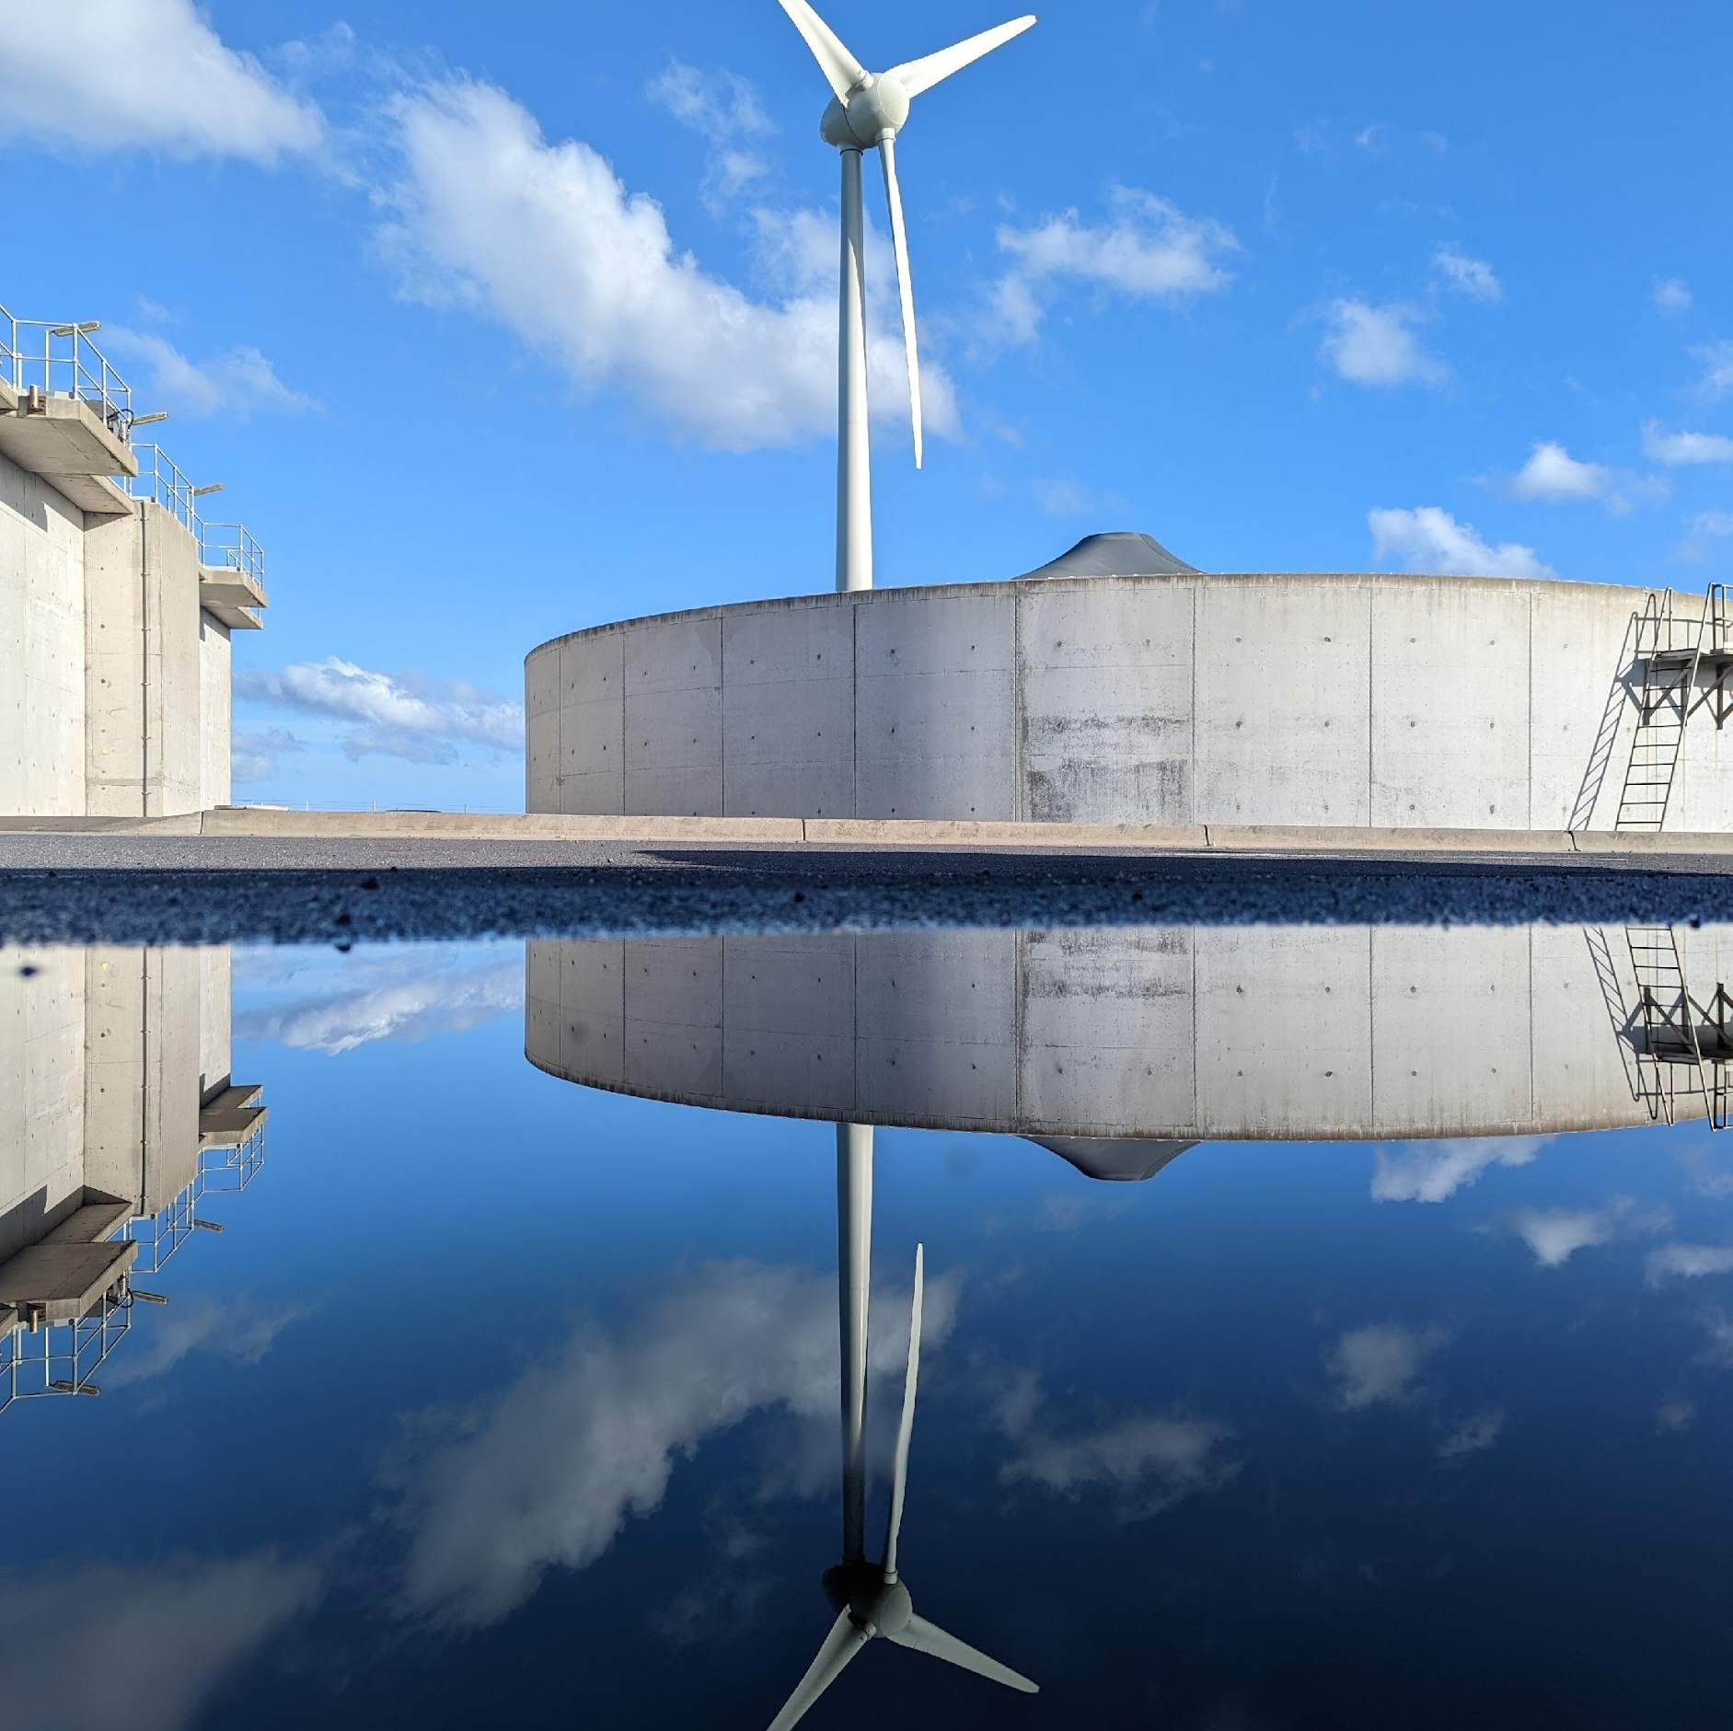

Learning intentions
To review the natural water cycle and the urban water cycle.
To gain an understanding of ecosystem services and their importance in the context of water cycle management.
To explore the Integrated Water Management (IWM) approach and its significance for sustainable water resource utilisation.
To design an IWM plan appropriate for a specific region.

Slide 7
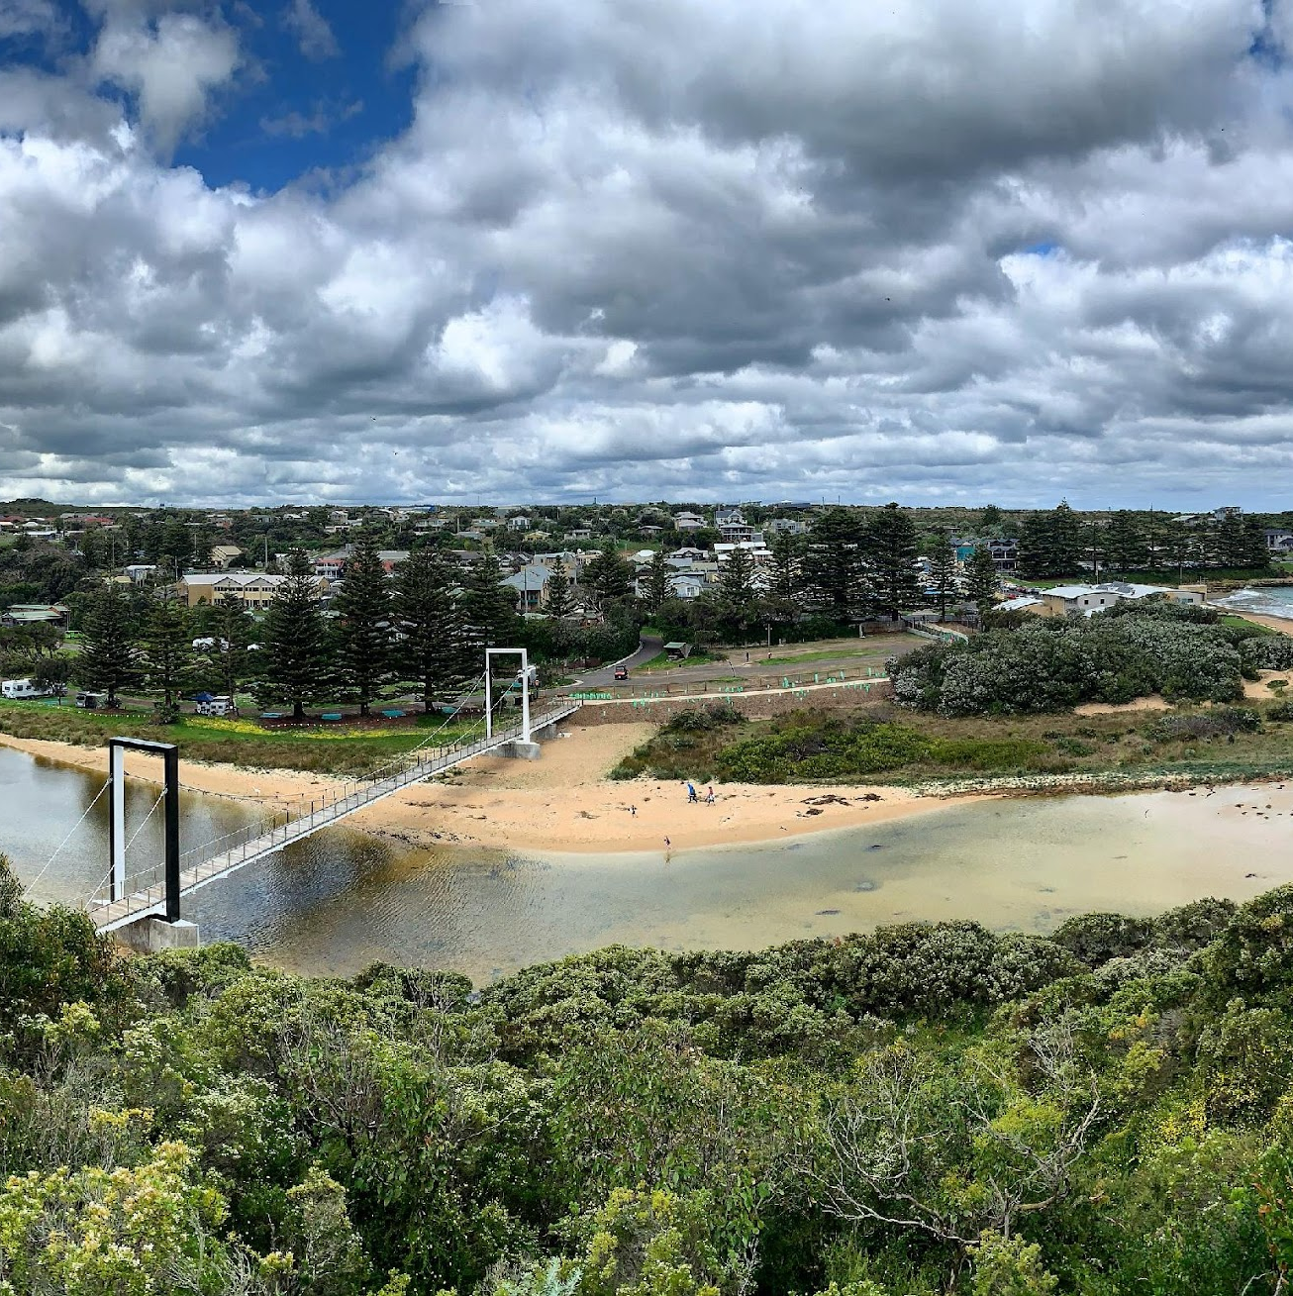
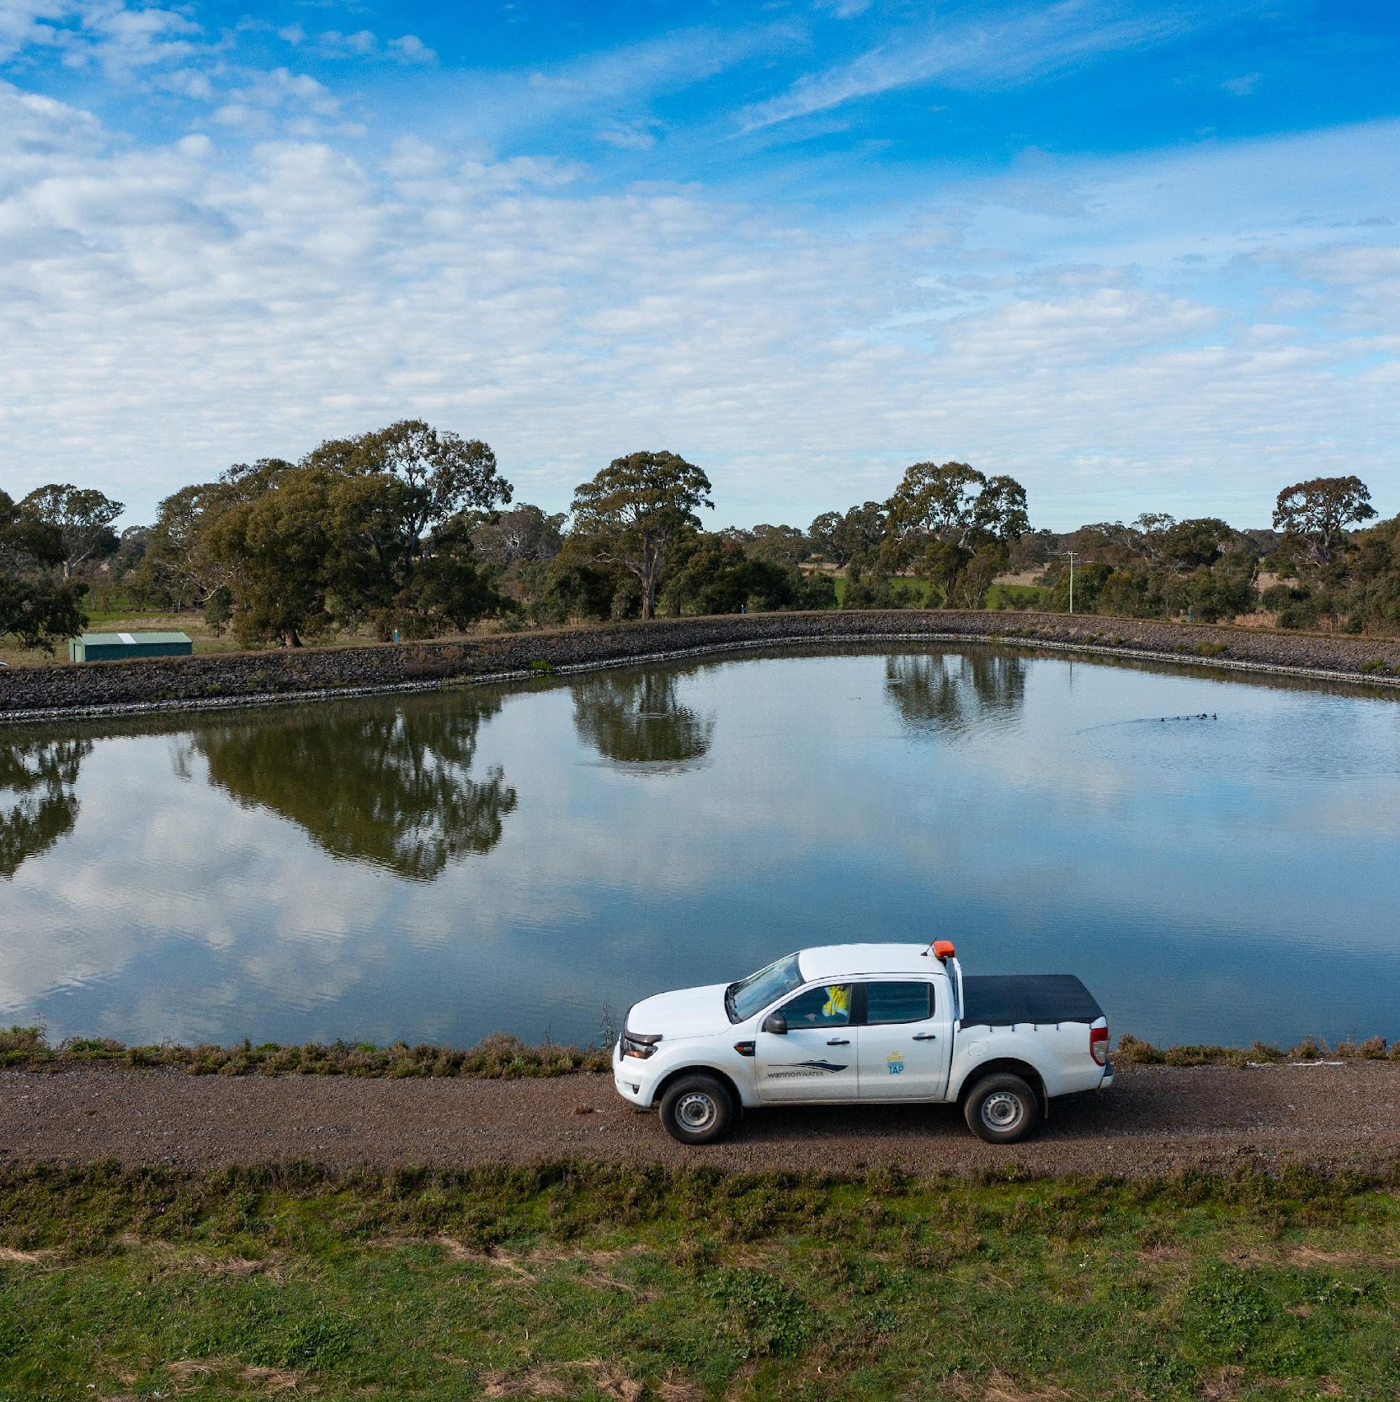
Success criteria
I can explain what ecosystem services are and why they are important to water cycle management.
I can understand what Integrated Water Management (IWM) is and why it is necessary for water security and sustainability.
I can design an IWM plan for a region,
taking into account factors such as town
size, natural water sources and average
personal water usage.

Slide 8

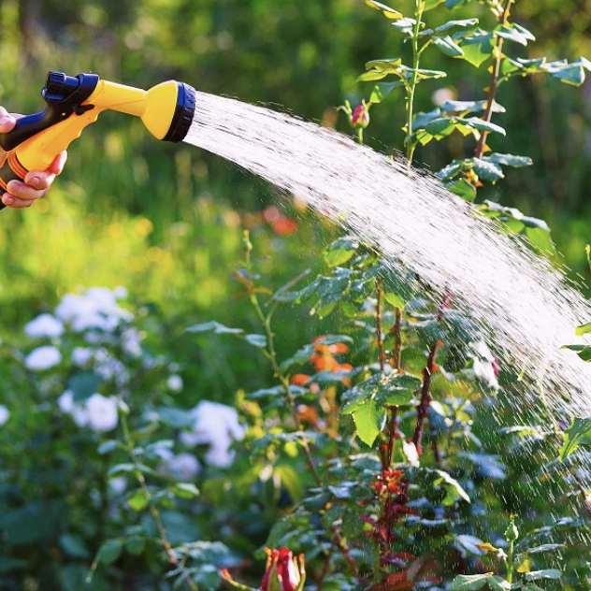



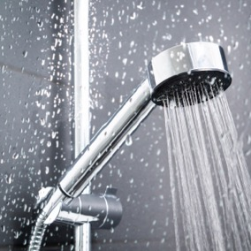
How does water move through our environment?
How do we use water?
Brainstorm / mind map / word splash (work in small groups)
The key ways water is used in modern communities… Discuss…
Notes:
(health and hygiene, flora and fauna/biodiversity, farming/agriculture/food production and security, leisure/social/wellbeing, industry etc)

Slide 9
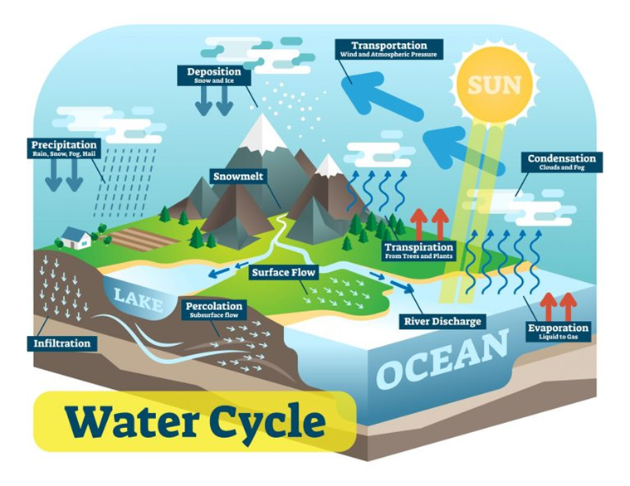
Natural Water Cycle
To be updated with new diagrams once completed

Slide 10
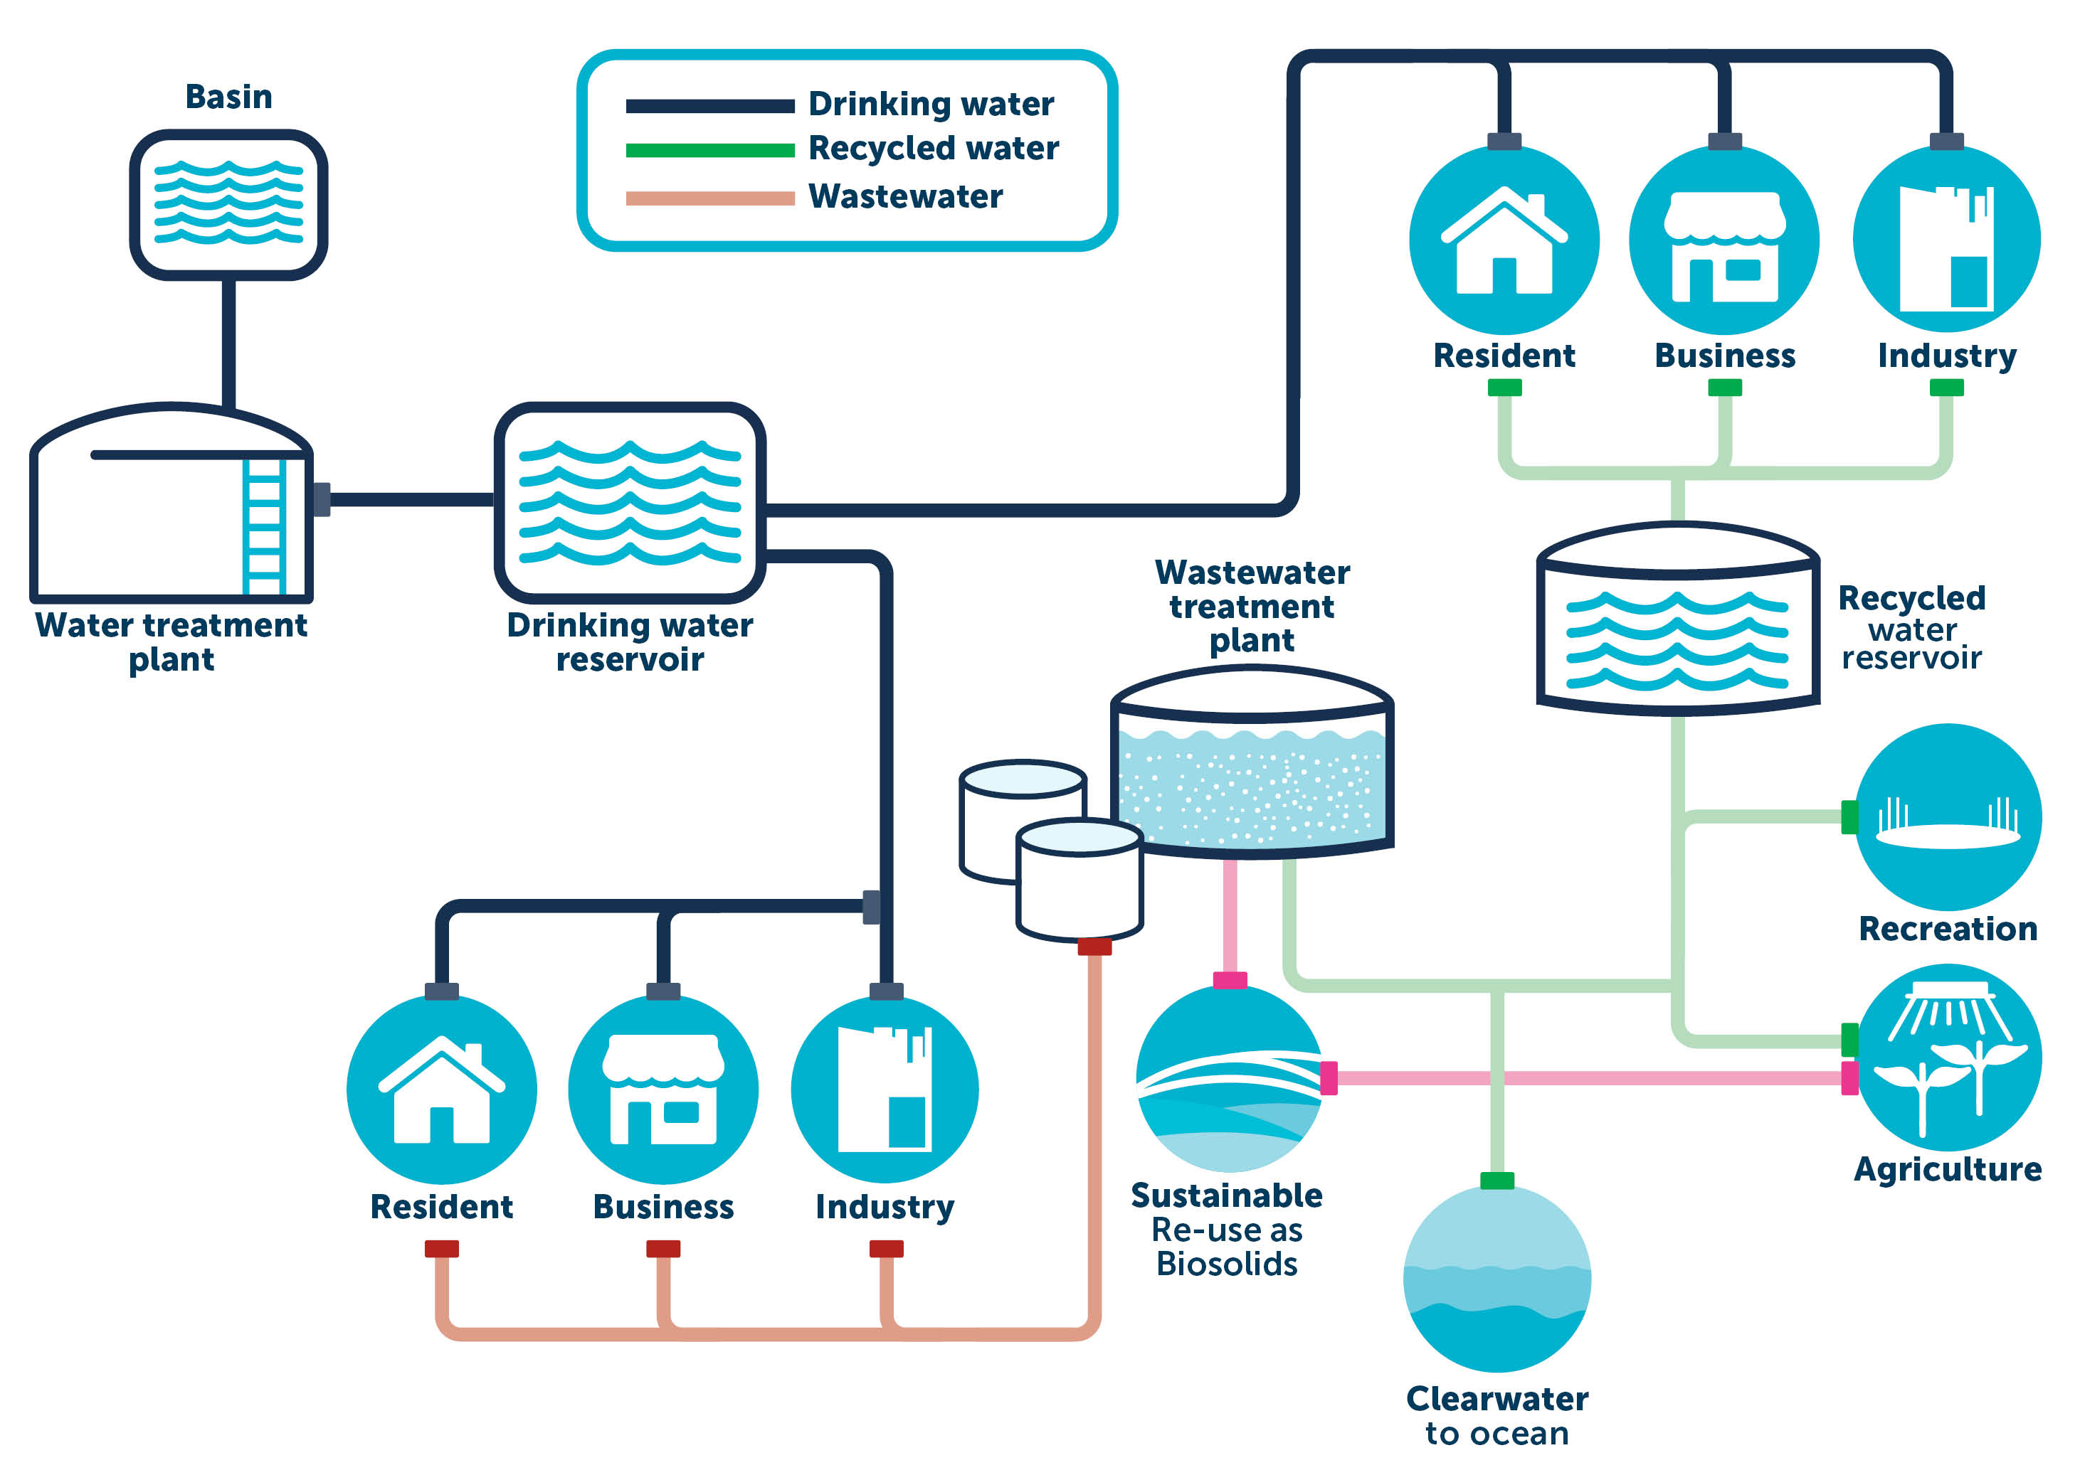
Urban
Water
Cycle

Slide 11
Natural Water Cycle vs Urban Water Cycle
To be updated with new diagrams once completed

Slide 12
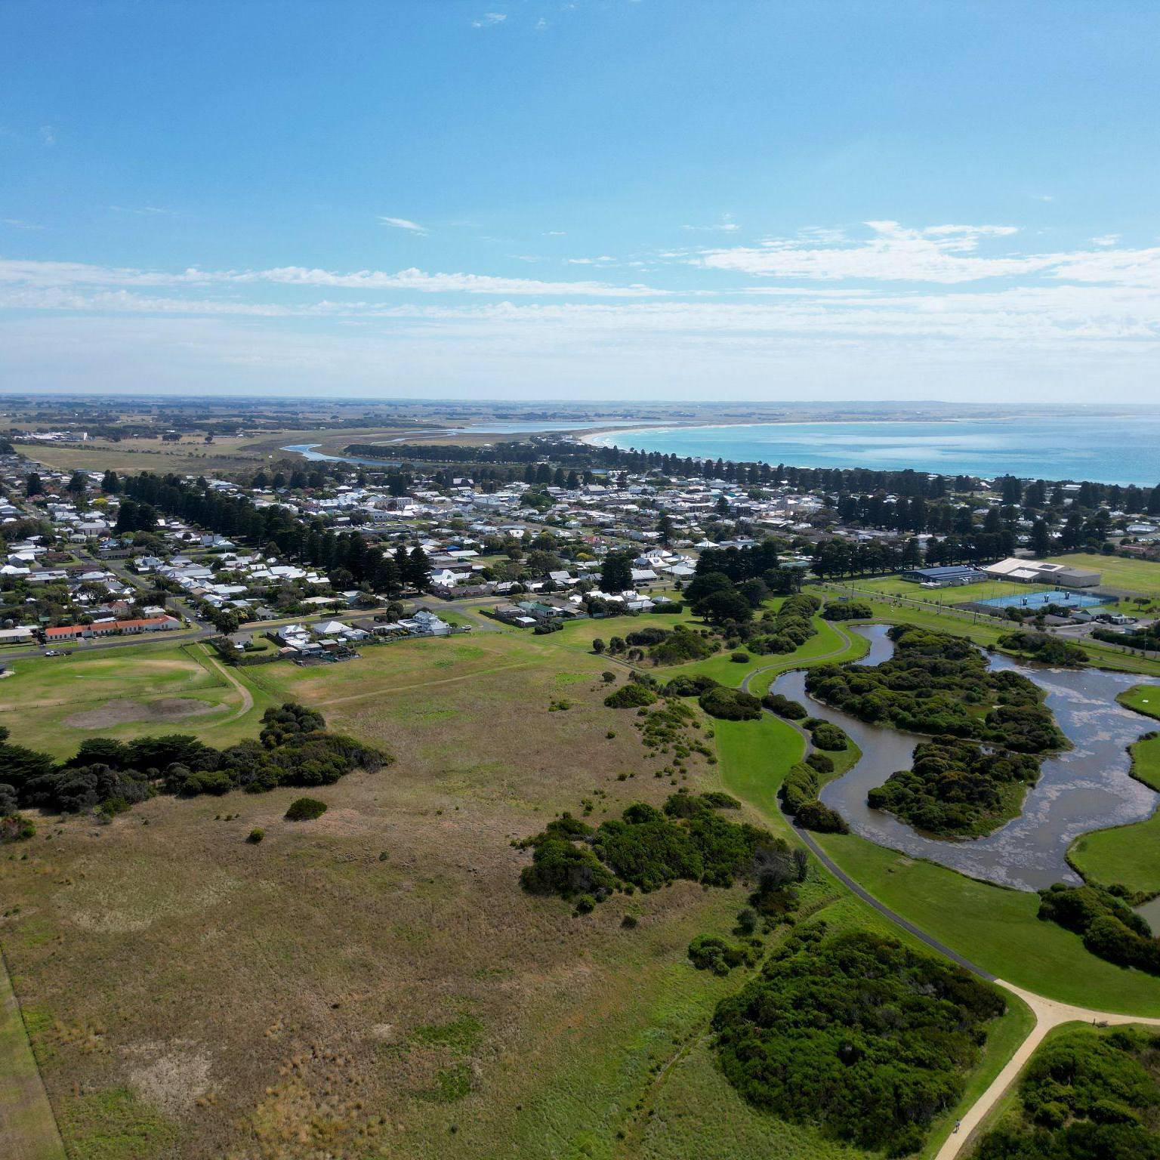
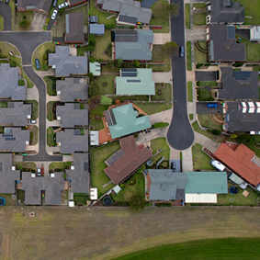
What do you understand now, after viewing both diagrams?
What is urbanisation?
What are the similarities and differences between the Natural Water Cycle and Urban Water Cycle?
How has urbanisation impacted on the Water Cycle?

Slide 13
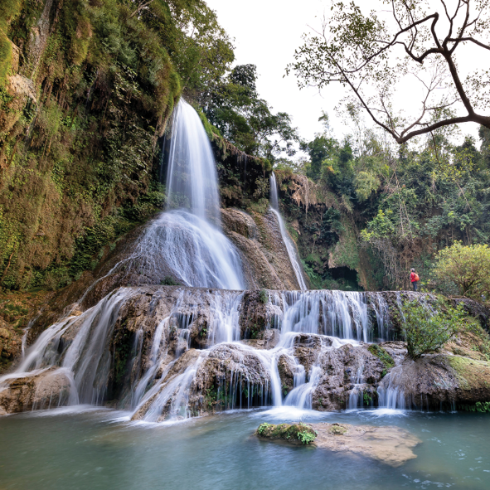
What are Ecosystem services?
Ecosystem services and their continued provision underpin
human existence, health and prosperity.
Governments, communities and natural resource managers are taking a broader ecosystem approach to decision making for
natural resource management issues that can achieve multiple benefits for landowners and society.
Biodiversity is central to the production of ecosystem services; it is the direct source of services, such as food and fibre, and underpins others, such as clean water and air, through the role of organisms
in energy and material cycles.
Credit: www.dcceew.gov.au/environment/biodiversity/publications/ecosystem-services-key-concepts-and-applications

Slide 14
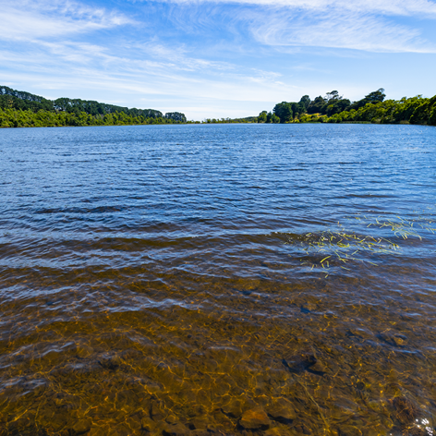
Ecosystem services
An introduction
Click on the following slide to watch the video
(2.40mins)

Slide 15
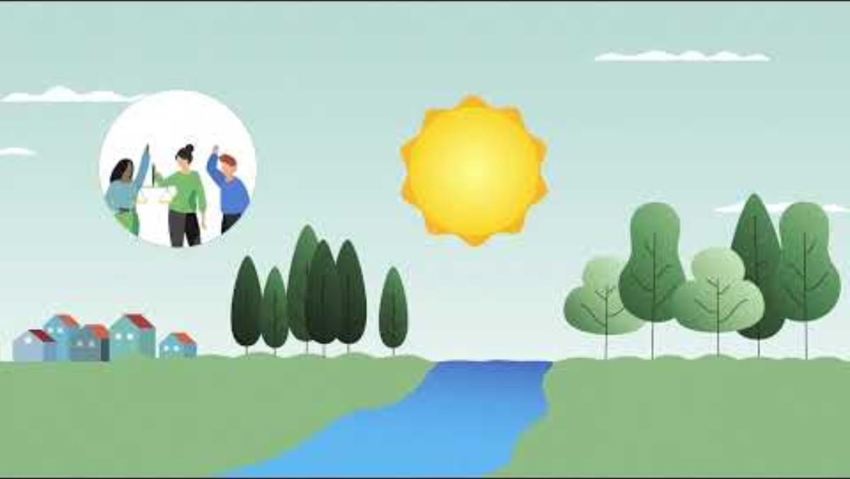

Slide 16
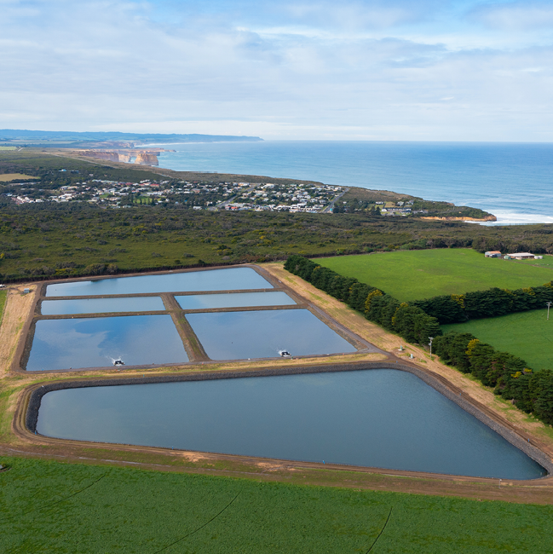
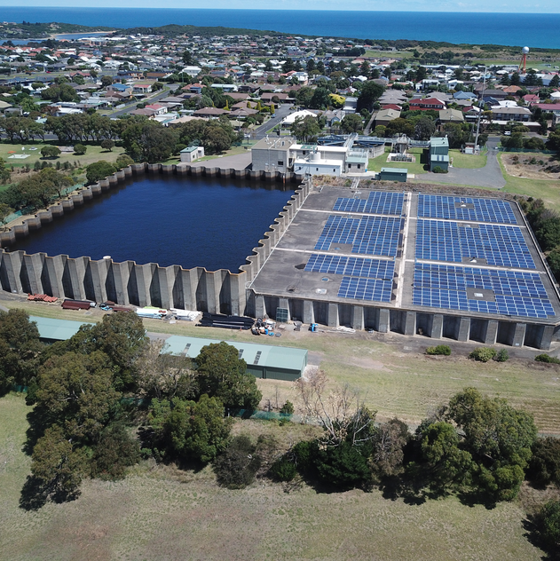
Ecosystem services
What are the key messages?
We need sustainable and healthy ecosystems for human survival and the health of our environment.
The way we manage and engage with key resources impacts both us as humans,
and the environment.

Slide 17
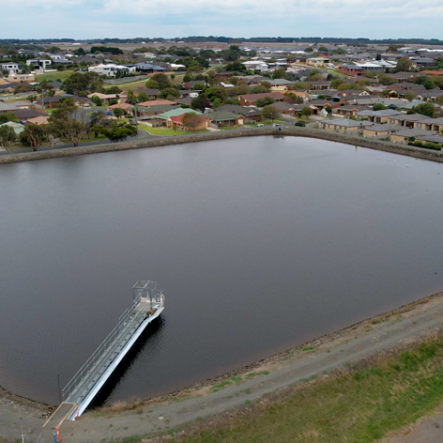
Integrated Water Management
What is it and why is it important?
Watch this video (embedded in the following website) to gain an understanding of Integrated Water Management
www.water.vic.gov.au/our-programs/integrated-water-management#:~:text=Integrated%20Water%20Management%20(IWM)%20is,environmental%20health%20and%20urban%20amenity

Slide 18
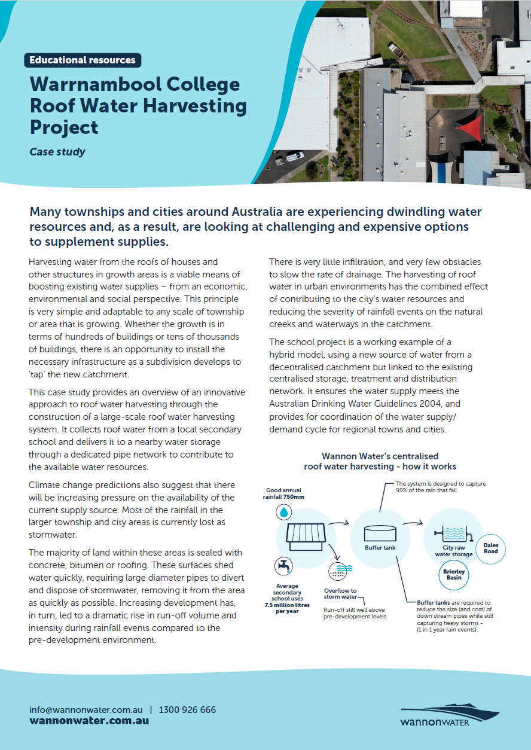
Integrated Water Management
in the Wannon Water Region
Explore the following Wannon Water website links to access information about Integrated Water Management and Sustainable initiatives in our region:
Warrnambool College Roofwater Harvesting factsheet
Roof water harvesting system - Wannon Water
Wannon Water Brierly Basin Floating Solar

Slide 19
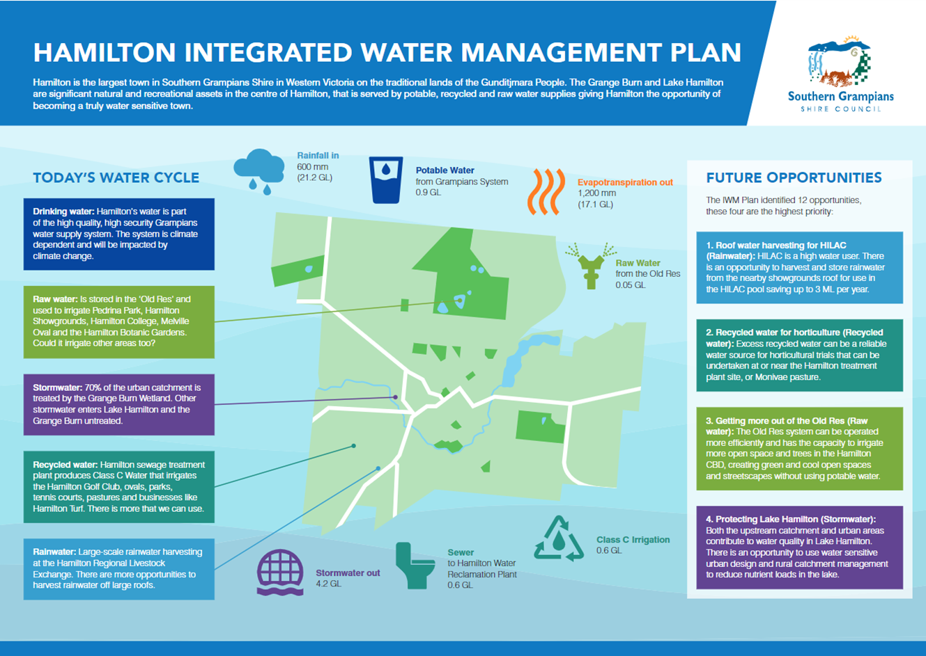
Hamilton Integrated Water
Management Plan
Download and view larger
Notes:
This is just something potentially we could use as well… - Yes we could definitely upload as a factsheet or link

Slide 20
Key vocabulary
Water Security
When a community has enough quality water for survival and productive activity.
Sustainability
The ability to meet our own needs, without compromising the ability of future generations to meet their needs.
Water Sensitive Urban Design
Stormwater is rainwater that has fallen onto roads or roofs and often contains chemicals or pollutants. Water sensitive urban design (WSUD) is an approach to planning and designing urban areas to make use of this valuable resource and reduce the harm it causes to our rivers and creeks.
Credit: www.melbournewater.com.au/building-and-works/stormwater-management/introduction-wsud
Notes:
This is just something potentially we could use as well…

Slide 21
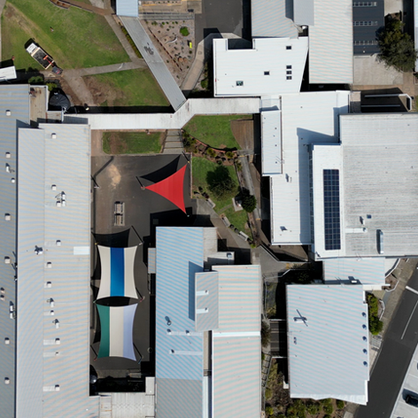
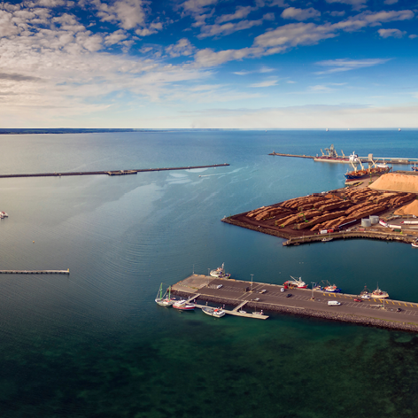
Integrated Water Management (IWM), Water Sensitive Urban Design and Sustainability
Task - in collaborative groups
Imagine you are a team responsible for Integrated Water Management, ensuring Water Security and Sustainability for the future of your chosen region…
Notes:
This is just something potentially we could use as well…

Slide 22
Considering a ‘Water Sensitive Urban Design’ approach to planning, design ONE simple IWM strategy to increase Water Security for your chosen region into the future and provide sustainable benefits to the environment…
Region 1 | Region 2 | Region 3
Australia Small agricultural community Population - 10,000 across small town, small and large scale farms Irrigation to some farms Bore, tank, dam water supply | Australia Small coastal city Population = 40,000 Access to town piped water supply for all | Asia Pacific Developing country, large urban city Population 10 million Various water supplies - town catchment piped supply, bores, wells, tanks, rivers, streams
Average personal water use = 150 L per day | Average personal water use = 164 L per day | Average personal water use = 130 L per day

Slide 23
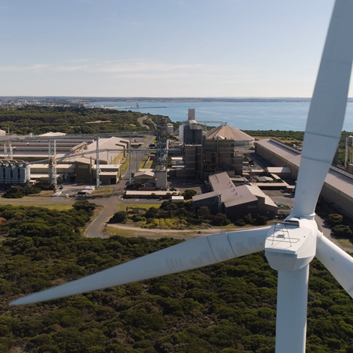
Task specifics
Design and outline one Water Sensitive Urban Design - IWM plan that will increase Water Security for the region into the future and provide sustainable benefits to the environment.
Give a clear justification for WHY and HOW this approach will benefit both the human population and environment in the region. Be specific and remember to justify your reasons along the way.
Outline briefly your thoughts on how Water Security will impact on human wellbeing into the future.
Present as a poster or a slideshow to share with the class.
Notes:
This is just something potentially we could use as well…

Slide 24
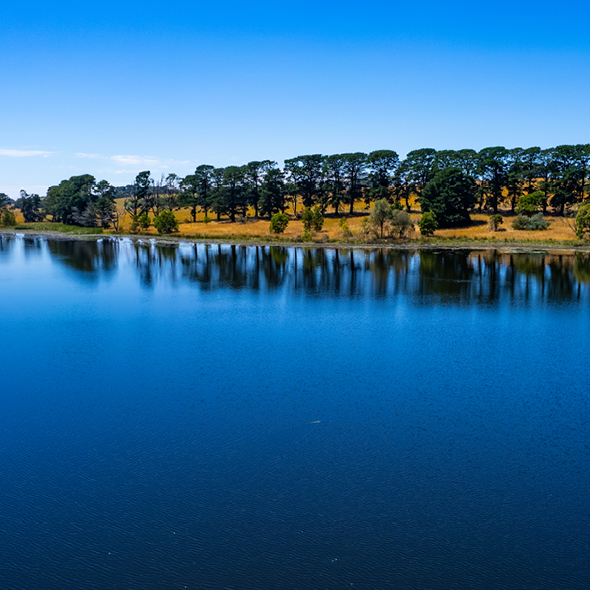
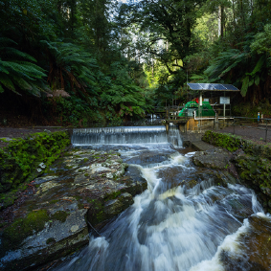
Share and reflect
Share and compare Integrated Water Management plans
Discuss and justify - compare similarities and differences.
Are our plans sustainable?
Will they ensure Water Security into the future?
Notes:
This is just something potentially we could use as well…

Slide 25
Extension opportunities
Explore
Choose another region and create a different plan to suit that region.
Create your own fictional town and design an IWM plan/approach.
Research
Find out about other global IWM approaches - summarise/outline.
Examine the UN water ecosystems website and briefly outline a number of future solutions to protect our global water resources - www.unwater.org/water-facts/water-and-ecosystems.
Examine the key facts and figures on the UN Water website. Summarise in a slideshow to share with your class - www.unwater.org/water-facts/water-and-ecosystems.
Notes:
This is just something potentially we could use as well…

