Slide 1
Year 7-8: Science
The Water Cycle: natural and urban perspectives

Slide 2
Notes:
Customise this slide with the Traditional Custodians group or Nation that you are meeting on
We acknowledge the Gunditjmara Peoples, the Eastern Maar Peoples, the Wotjobaluk, Jaadwa, Jadawadjali, Wergaia and Jupagalk Nations, and the Wadawurrung Peoples.

Slide 3
Notes:
Customise this slide with the Traditional Custodians group or Nation that you are meeting on
We acknowledge the Gunditjmara Peoples, the Eastern Maar Peoples, the Wotjobaluk, Jaadwa, Jadawadjali, Wergaia and Jupagalk Nations, and the Wadawurrung Peoples.

Slide 4
About us
Every day, we supply South West Victoria with sustainable water services, while leading our communities towards a healthier, more prosperous future. It’s a commitment that we’re proud to make to the region we call home.
We’re your local, dependable experts
From the South Australian border to the Otways. From the Grampians to the coast. Our services take care of more than 30 communities, including residents, farmers, businesses and industries. It’s our responsibility to supply you with fresh water, from source to tap, and manage sewage to protect your health and wellbeing.
Putting people first comes naturally to us so we’re here to help with more affordable, reliable and personalised service. You’ll see us around, in towns and on streets, maintaining and upgrading the pipes, pump stations and treatment plants we all need.
We’re making a real and positive difference
As locals, we’re driven to shape our region for the better. We’re committed to working with our communities and strategic partners to support the health and wellbeing of our people and protect our natural environment. We simply believe it’s the right thing to do and it all comes back to our greater vision to go beyond water for stronger communities.
It’s about delivering sustainable water services together with positive changer our region – and we’re proud to be leading the way.
er catchment, treatment and supply in our region

Slide 5
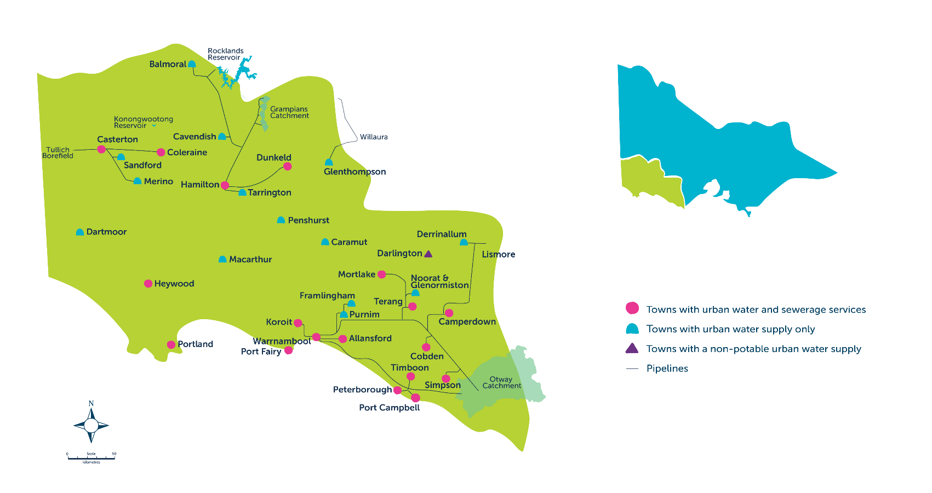
Our region

Slide 6
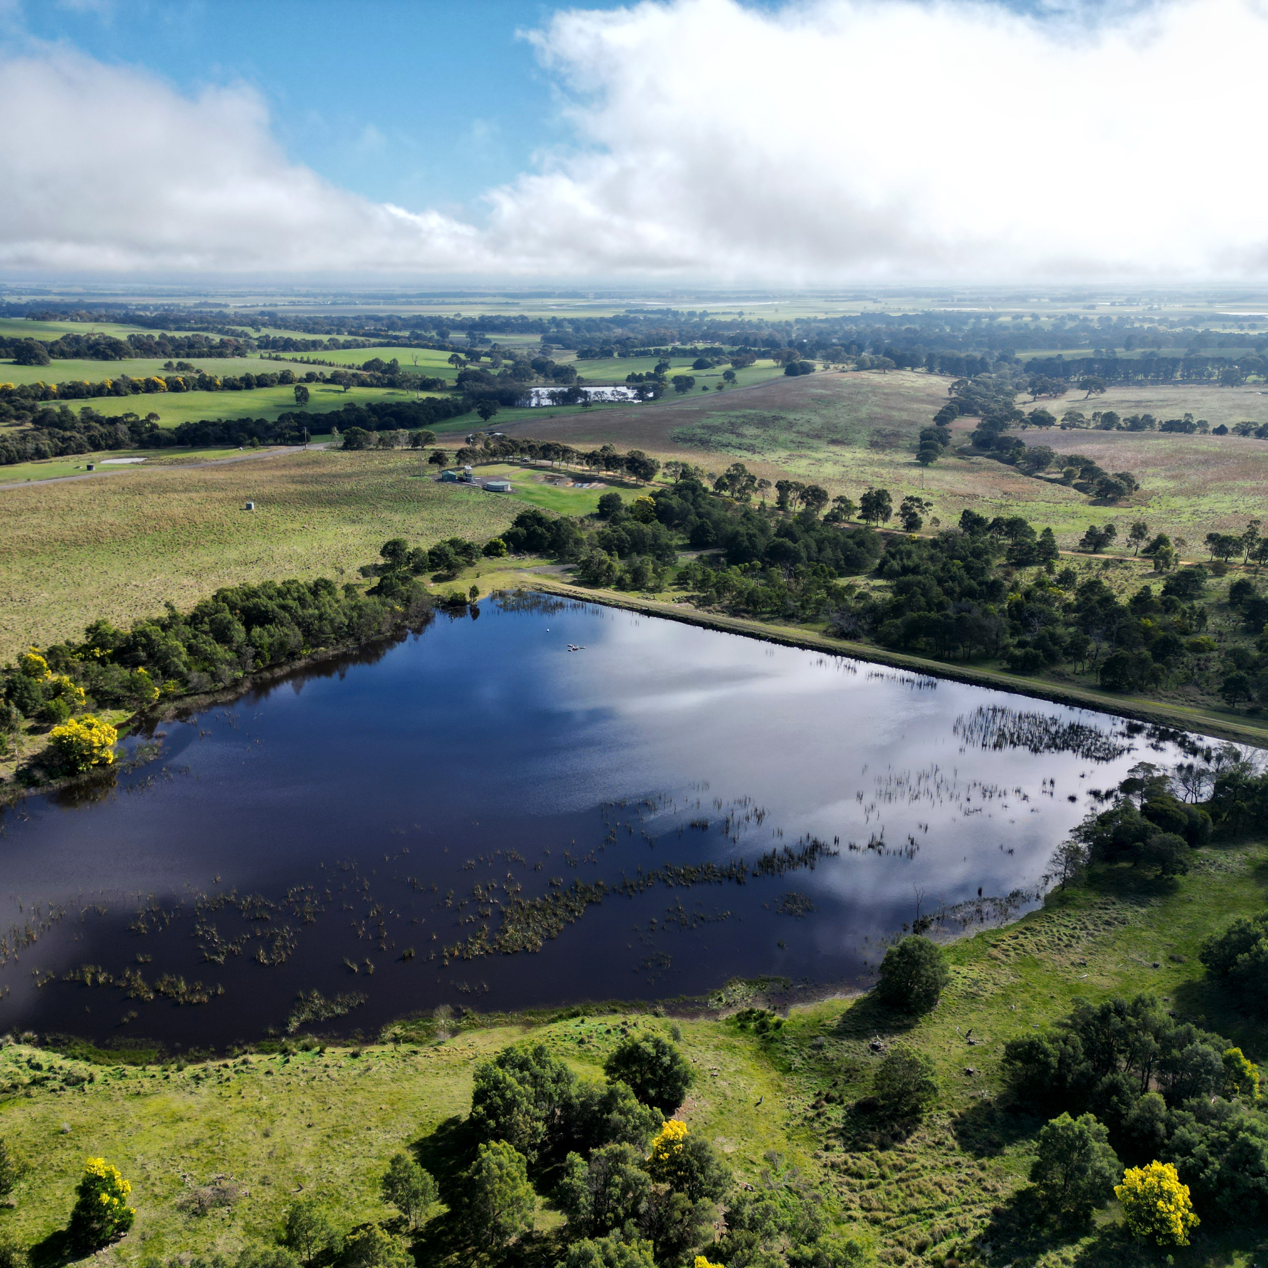
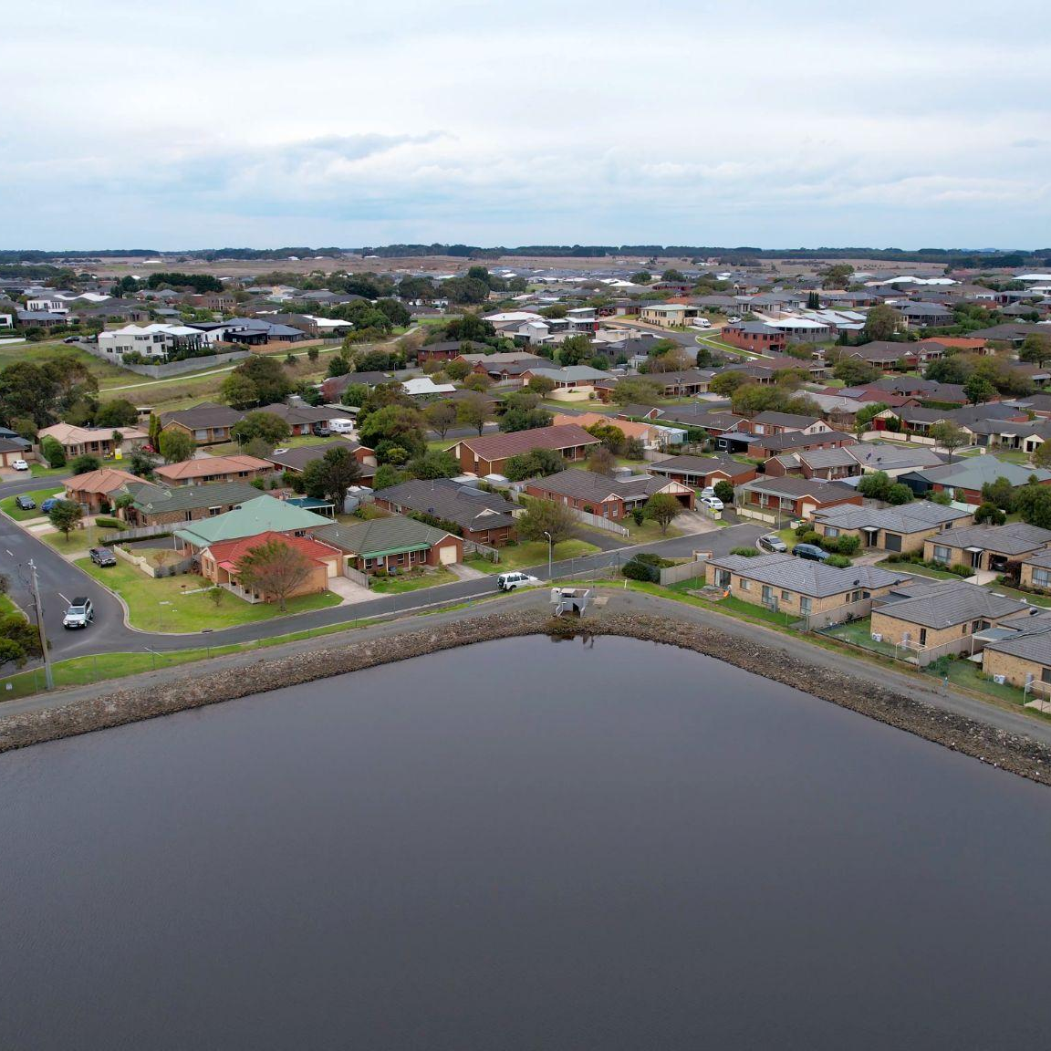
Success criteria
I can describe the flow of water in the natural water cycle.
I can compare and contrast the natural and urban water cycles.
I can outline who manages water in our water region.

Slide 7
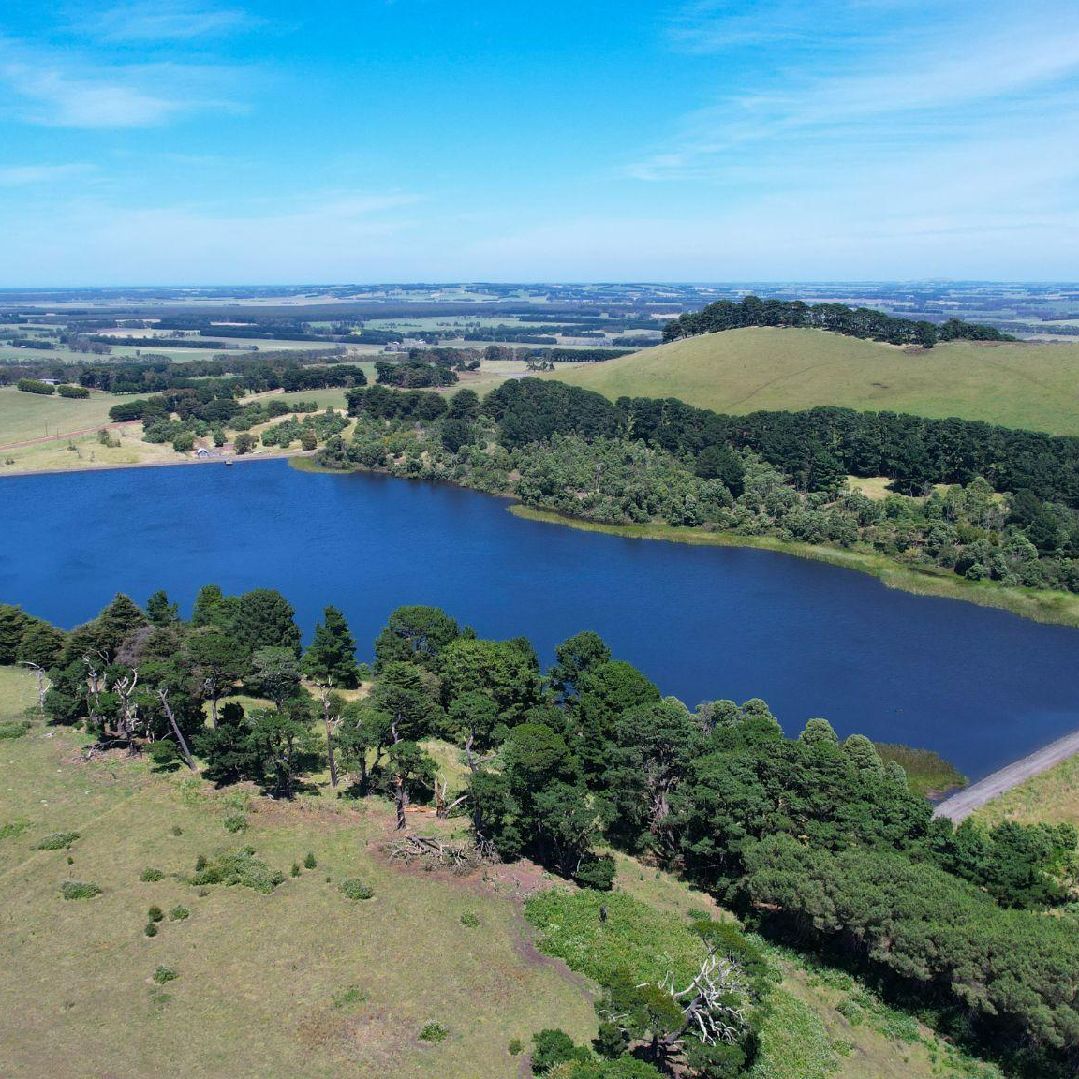
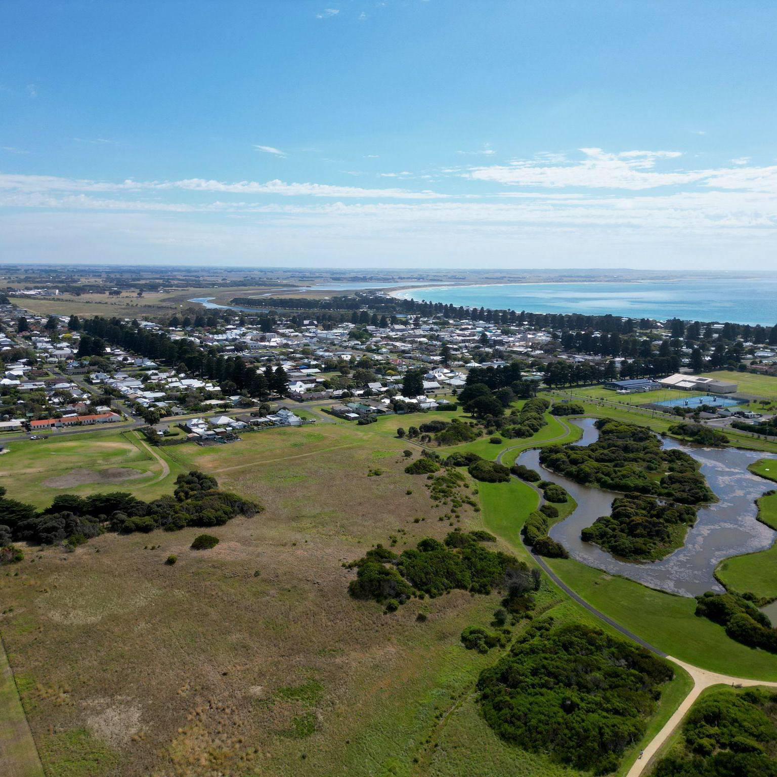
Learning intentions
To understand that water is a renewable resource that moves in cycles.
To consider the water cycle in terms of changes of states of matter.
To investigate factors that influence the water cycle in nature.
To explore how urbanisation and human management impact the water cycle.

Slide 8
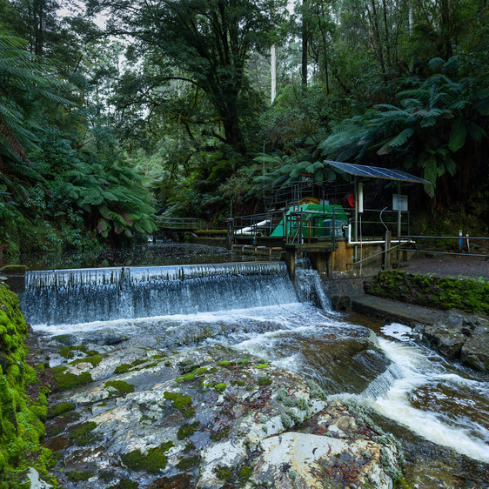
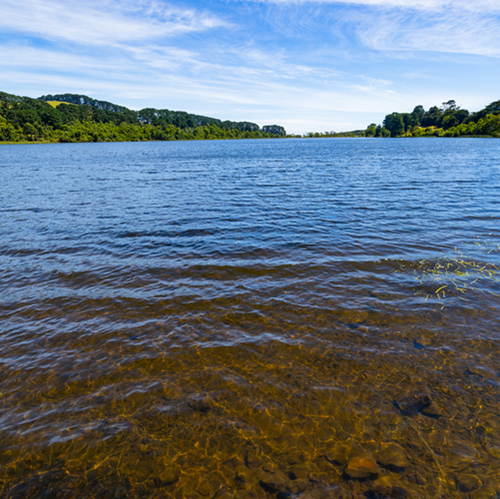
Class discussion
How does water move through our environment?
Notes:
Prompt examples - ocean, rain, cloud, river, catchment. Could introduce technical vocab, e.g., evaporation, condensation, precipitation, transpiration, reservoir

Slide 9
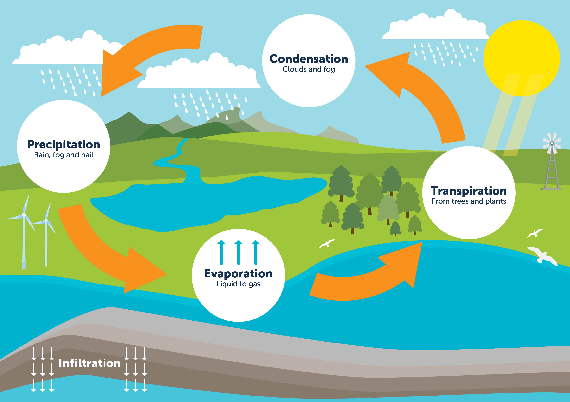
The Natural Water Cycle

Slide 10
Class discussion
What does ‘urbanisation’ mean?
How would the Water Cycle diagram look different in an urban environment?

Slide 11
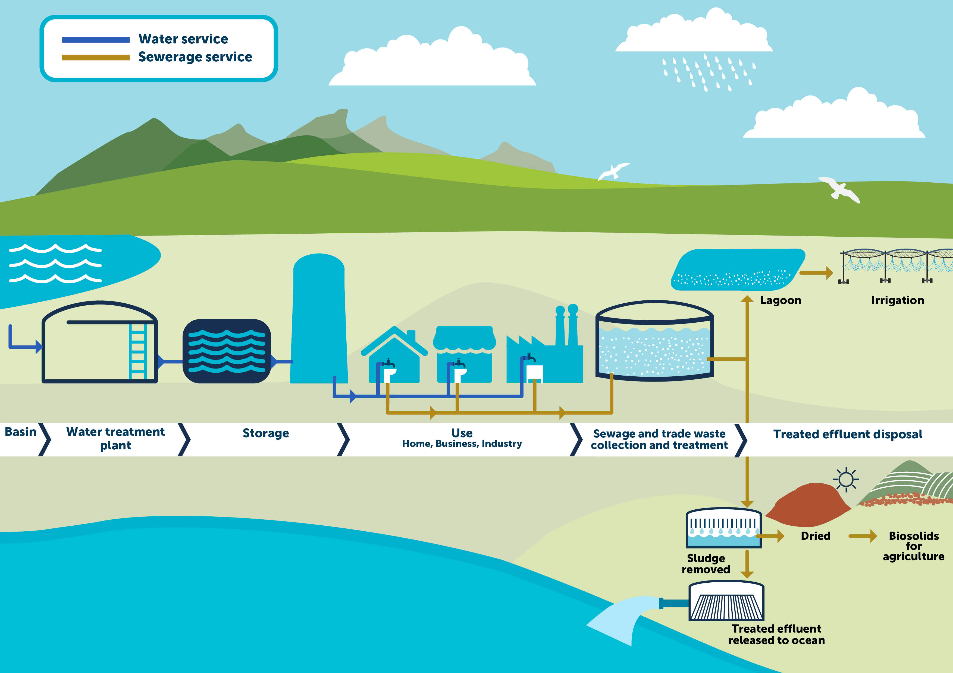
Urban
Water
Cycle

Slide 12
Natural Water Cycle vs Urban Water Cycle
What do you notice when comparing?

Slide 13
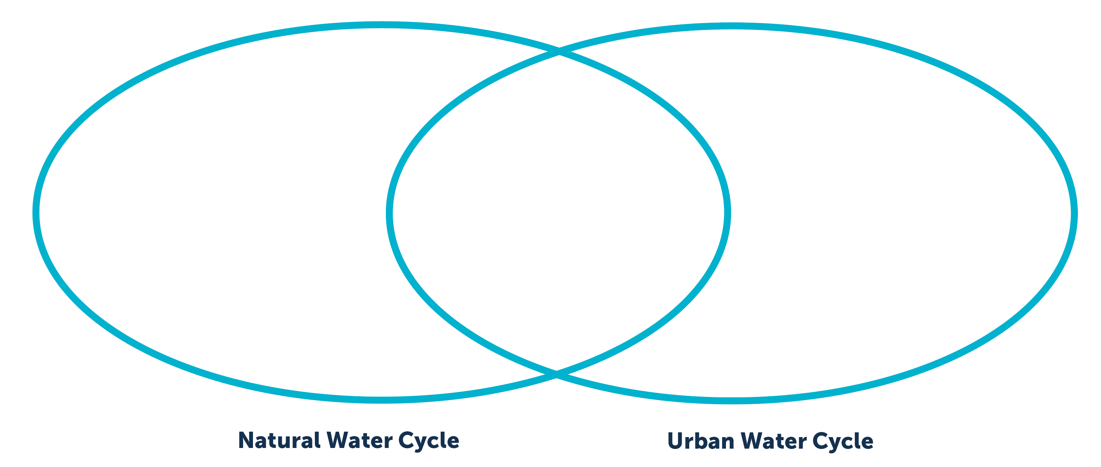
Compare and contrast the Natural and Urban Water Cycle
Choose a visual organiser
Use a Venn Diagram OR Top Hat Diagram OR your choice of digital flow chart / visual organiser app
Venn Diagram
Top Hat Diagram

Slide 14
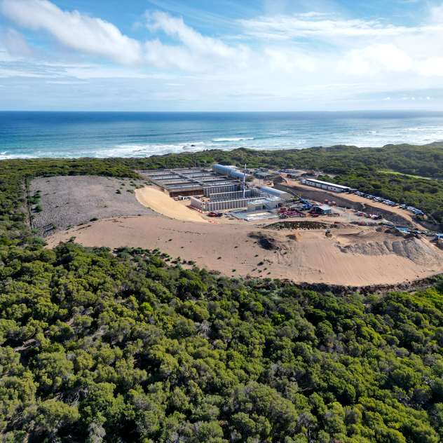
Discuss and highlight the additional factors in the Urban Water Cycle
What does this mean for human communities?...
That regional Water Authorities, Catchment Management Authorities and local councils must work together to manage -
Water supply
Impacts such as effluent, flooding, stormwater, runoff, etc…

Slide 15
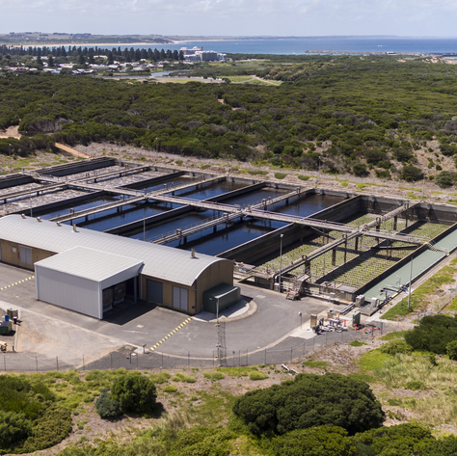
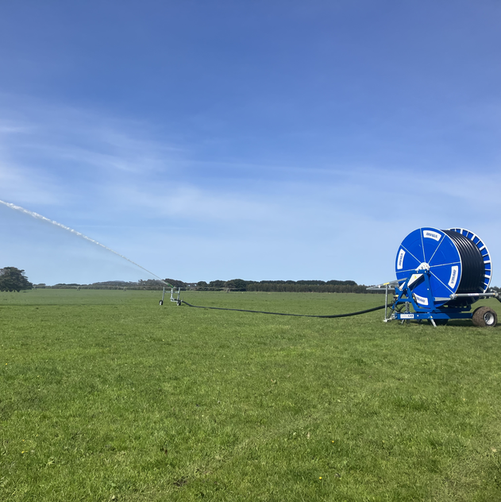
How does human management of water impact the water cycle? …
When dams are built and water is used for irrigation, water is diverted from natural river systems which affects natural ecosystems.
When effluent flows into rivers and oceans, it can also affect ecosystems.
This is why Water Authorities carefully treat wastewater to minimise environmental impacts.

Slide 16
What does Wannon Water do in our region?
Explore Wannon Water’s website using this link: www.wannonwater.com.au/about-us/our-role/
Record dot point notes to summarise who manages water in our region and what their roles are.

Slide 17
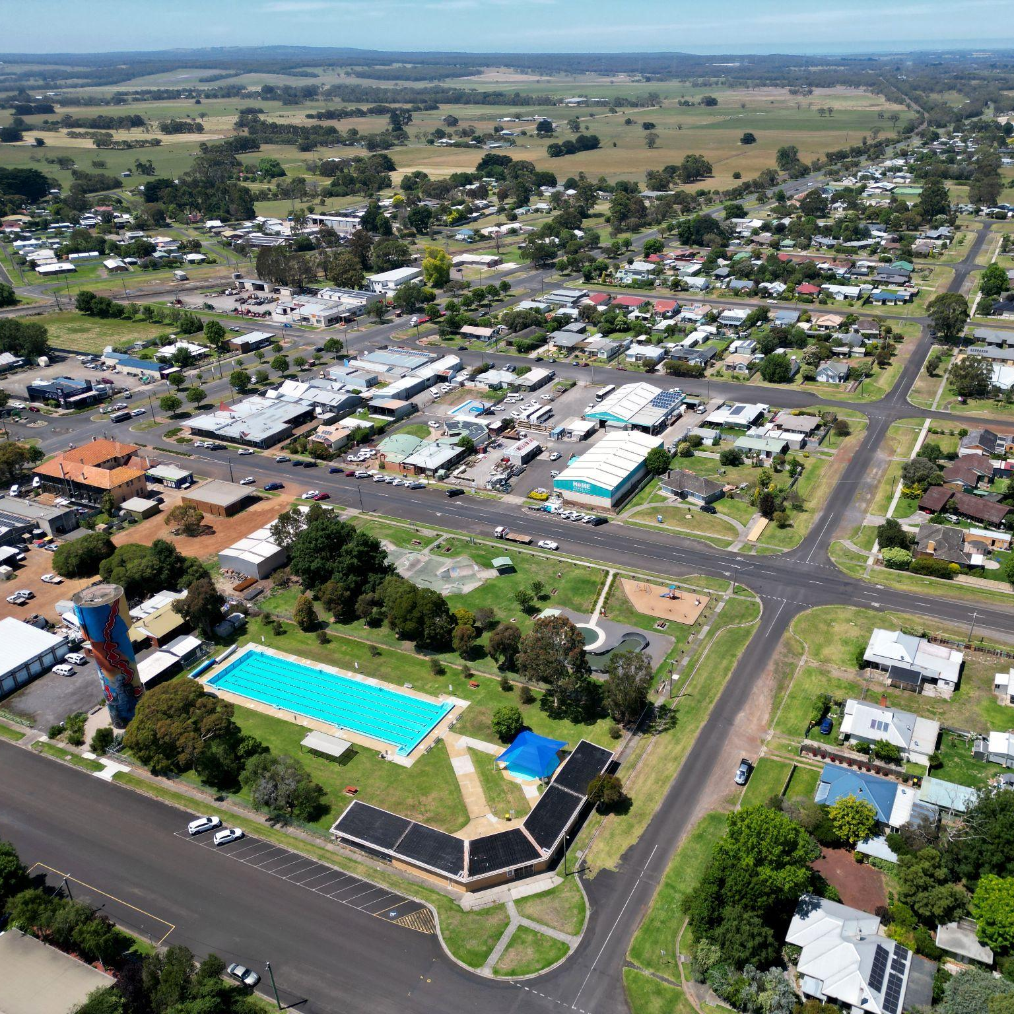
Share and reflect
Why does water need to be managed in our urban communities?
Who manages water in our region?
What challenges might these organisations face when managing water into the future?

Slide 18
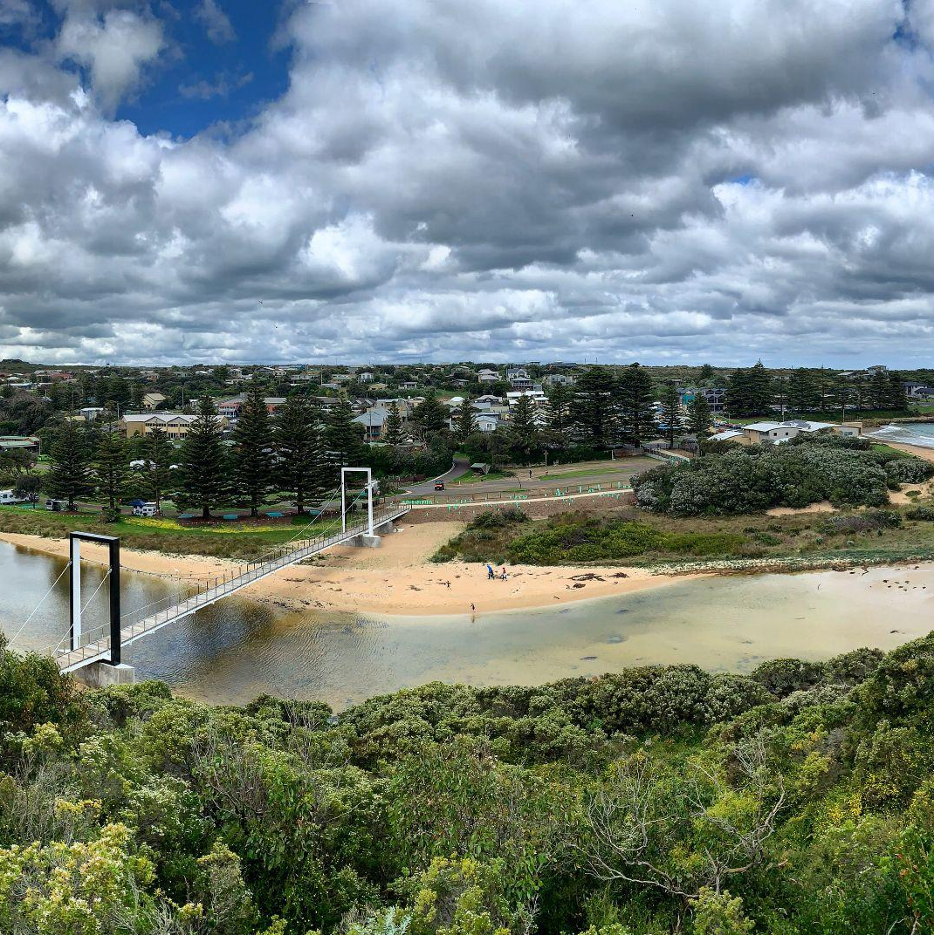
Extension opportunities
Complete a Water Cycle practical experiment of your choice to consolidate learning about the stages of the water cycle and technical vocab.
Take a ‘Water Walk’ - observe and map water supply infrastructure in your school grounds.
Consider how human management of water has changed since colonisation in Australia?
Research task - how does flooding impact on urban and regional communities? How does flooding change the way humans need to manage water? E.g. water quality, dam control, effluent, stormwater runoff, pollution, etc.

