Slide 1
Year 7-8: Geography
Water catchment, treatment and supply in our region

Slide 2
Notes:
Use this slide if you’d like to share a personalised Acknowledgement of Country

Slide 3
Notes:
Use this slide if you’d like to share a personalised Acknowledgement of Country

Slide 4
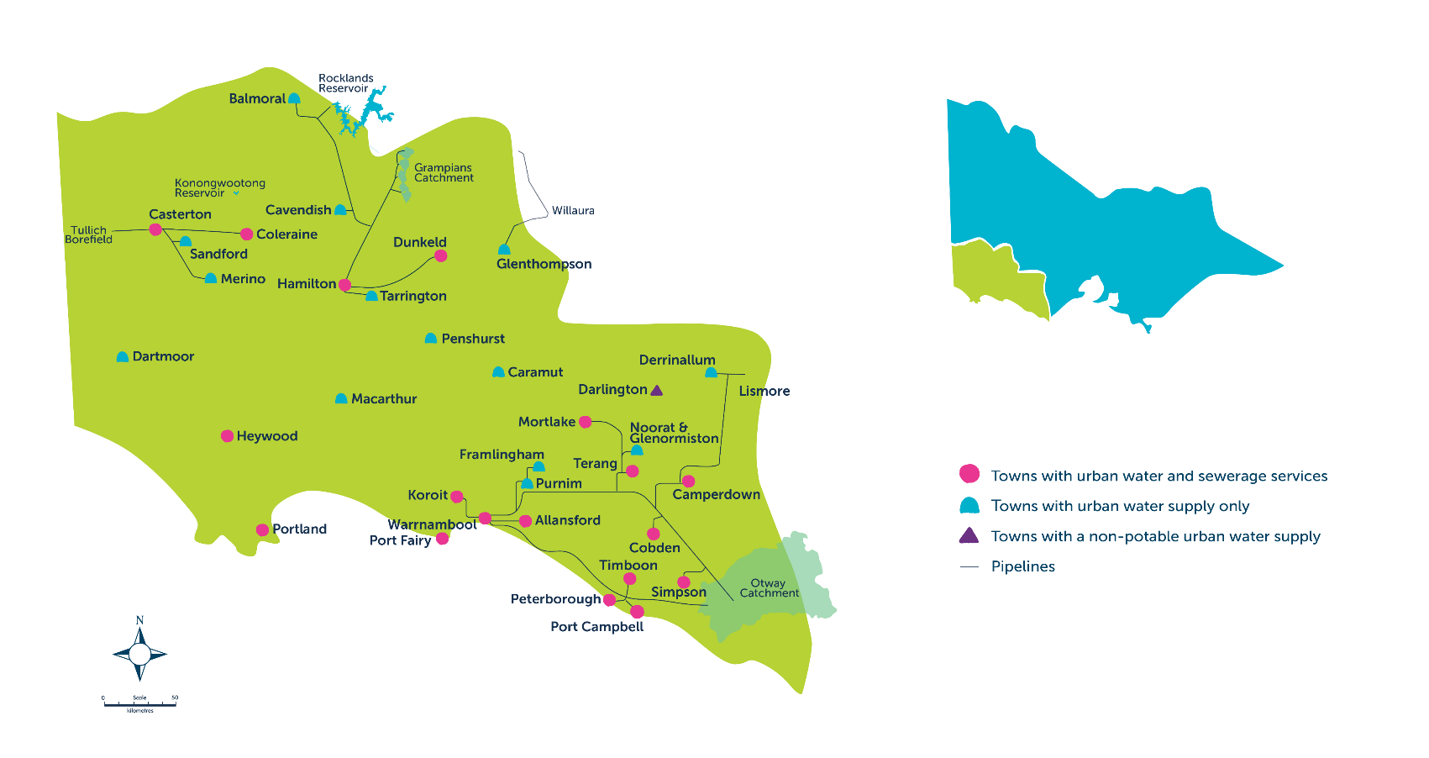
Our region

Slide 5
Learning intentions
To explore the various water sources in our region.
To research how water is treated and stored in our region.
To summarise key information about the movement of water in the local water sources.

Slide 6
Success criteria
I can understand that we have multiple water supplies in our region.
I can research how water moves in one of the water supplies/sources in our region.
I can present my research to my class/small group.

Slide 7
Student name(s): Insert name(s)
Water supply system/source:
Insert name of water supply area, insert image

Slide 8
Where has the water come from?

Slide 9
How is the water treated?

Slide 10
How is the water stored and transported?

Slide 11
Other interesting facts

Slide 12
Water supply area map and images

